Slide 1
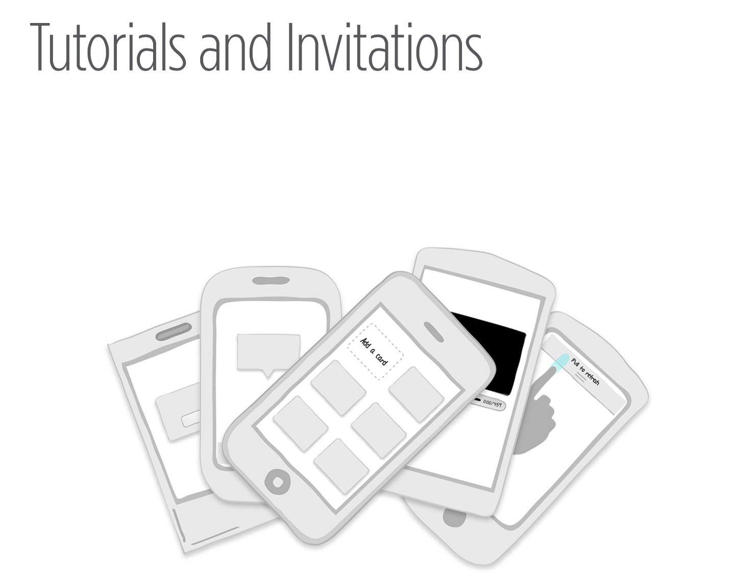

Slide 2
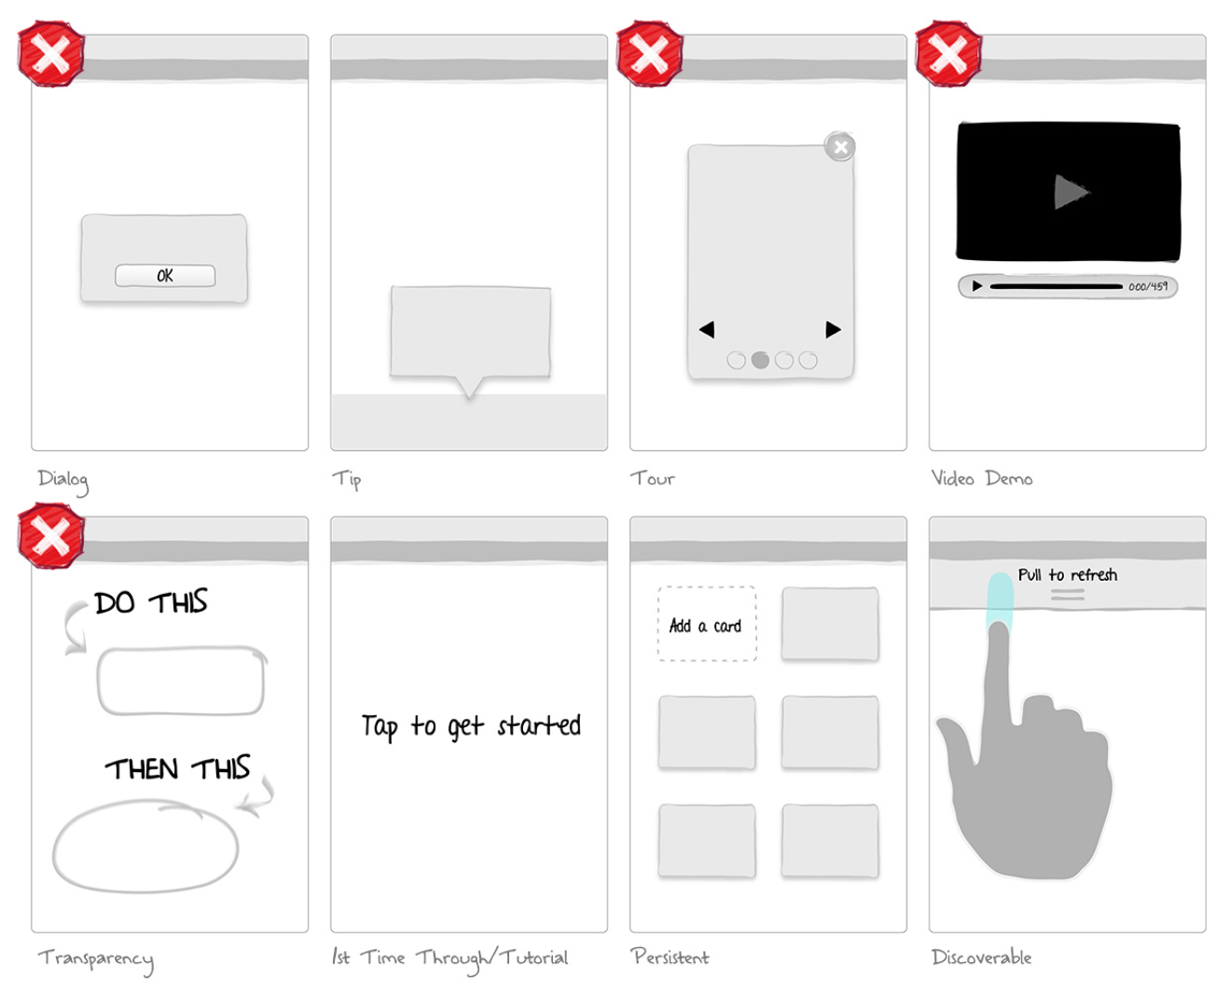
Notes:
FIGURE 7-1.
First edition patterns for invitations
In a nutshell, testing showed that users tend to skip or otherwise ignore Dialogs, Tours, Video Demos, and Transparencies. At best, users find them a minor inconvenience. At worst, they can cause sig- nificant aggravation to new users who are trying to get into the app. As one RetailMeNot test participant put it, “I just want to get in the app and start exploring.”
So with this new knowledge, we begin a new chapter. The first half of the chapter is devoted to explaining how to create an effective “first- time through” experience, also known as a tutorial or onboarding. The second part of the chapter looks at the invitation patterns that have been proven to work: Tips, 1st Time Through, Persistent Invitations, and Discoverable Invitations.

Slide 3
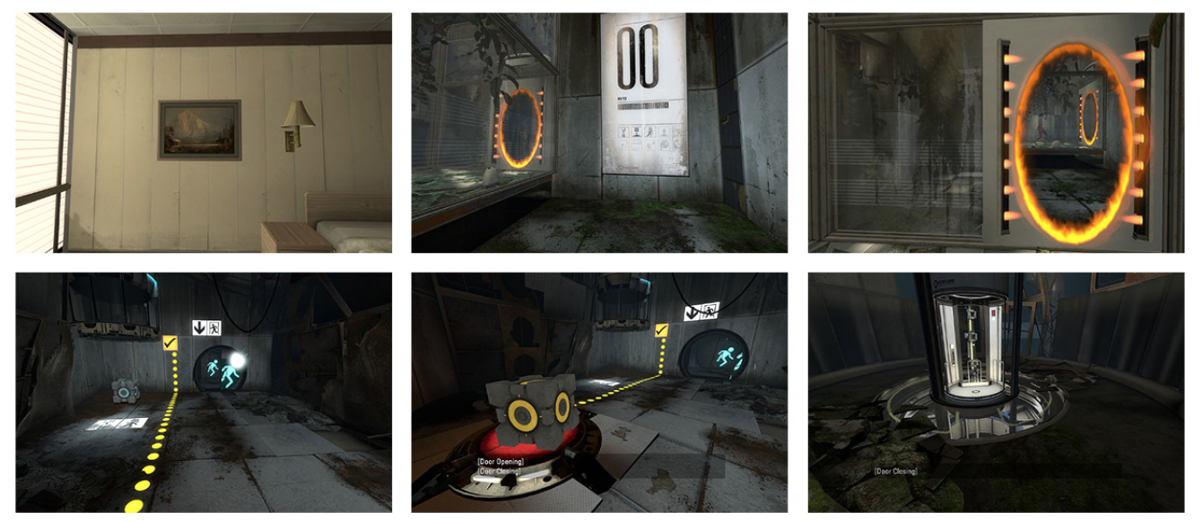
Notes:
FIGURE 7-2.
Portal offers a safe environment for players to figure out the controls while advancing in the game
So why don’t Dialogs, Tours, Transparencies, and Video Demos work well for onboarding new users? I turned to the field of game design for answers. Game designers have always known that you can’t drop new players into the middle of a firefight and expect them to enjoy the experience. Most players would be dead before they figured out how to fire their weapons and fight back.
In game design, some methods of driving deeper engagement are much more effective than others. The same holds true for mobile apps. While the stakes may not be (virtual) life or death, the frustration users experience when they don’t know how or what to do is the same. And when that happens to too many of your users, it’s game over for your app.
Tutorials 101 lays out some basic rules for crafting an effective game tutorial:
Use less text. 2. No frontloading. 3. Make it fun. 4. Reinforce learning through play.
5. Listen to your players.

Slide 4
Rule #1: Use Less Text
When we want to explain something, words often seem like the easiest tool to use. But when we want to learn something, the written word is often a turnoff.

Slide 5
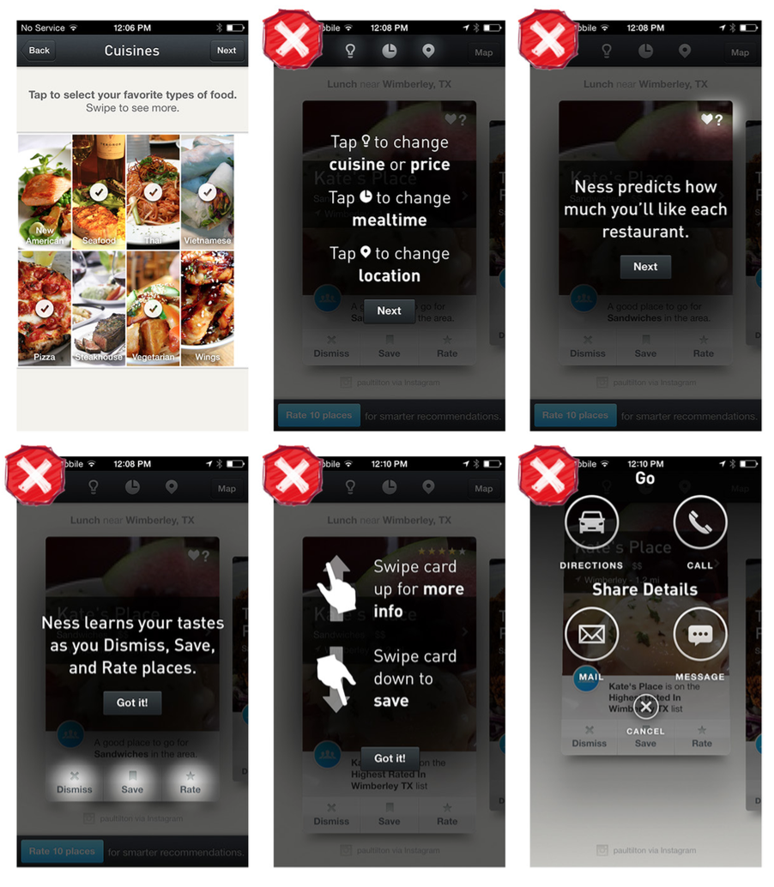
Notes:
FIGURE 7-3.
Ness for iOS: note that some prompts explain cause and effect rather than inviting the cause and letting users observe the effect

Slide 6
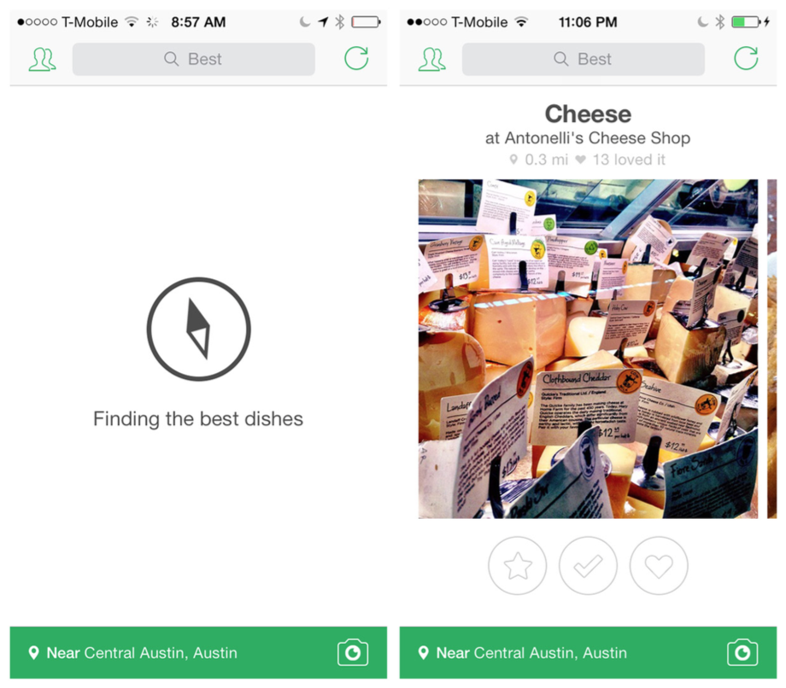
Notes:
FIGURE 7-4.
Foodspotting for iOS: an app so simple, it invites deeper engagement without users needing a tutorial

Slide 7
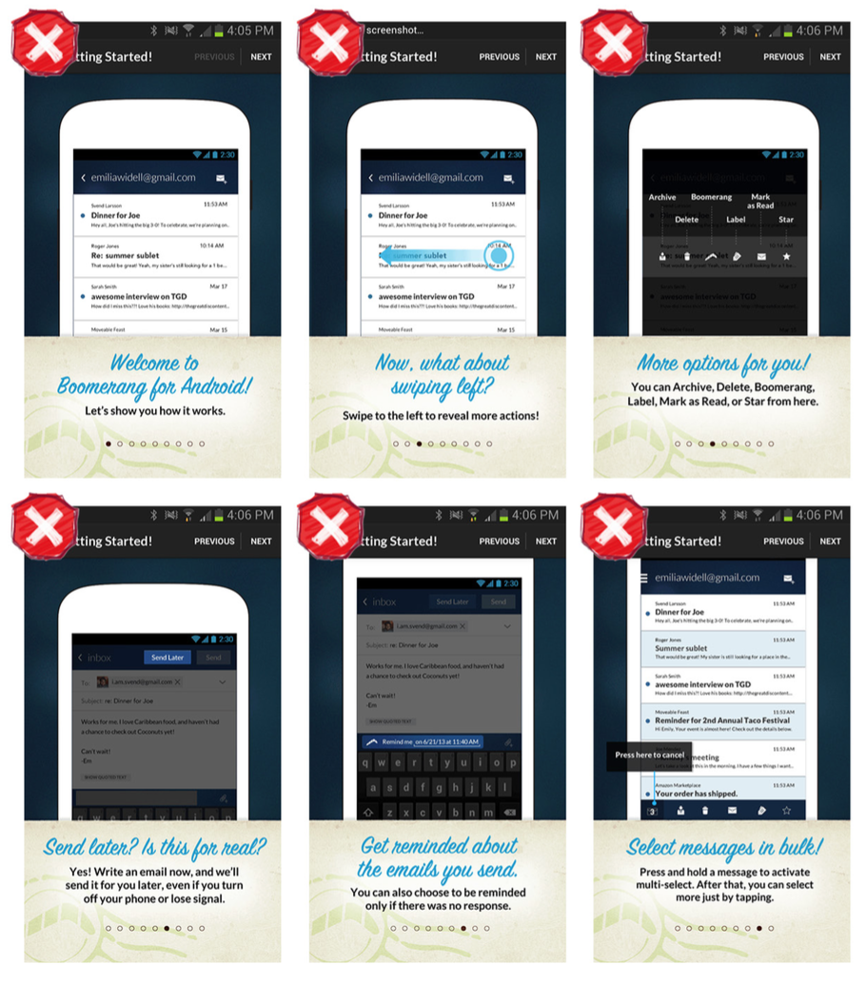
Notes:
FIGURE 7-5.
Boomerang for Android: too much text (also see “Rule #2, No Frontloading”)

Slide 8
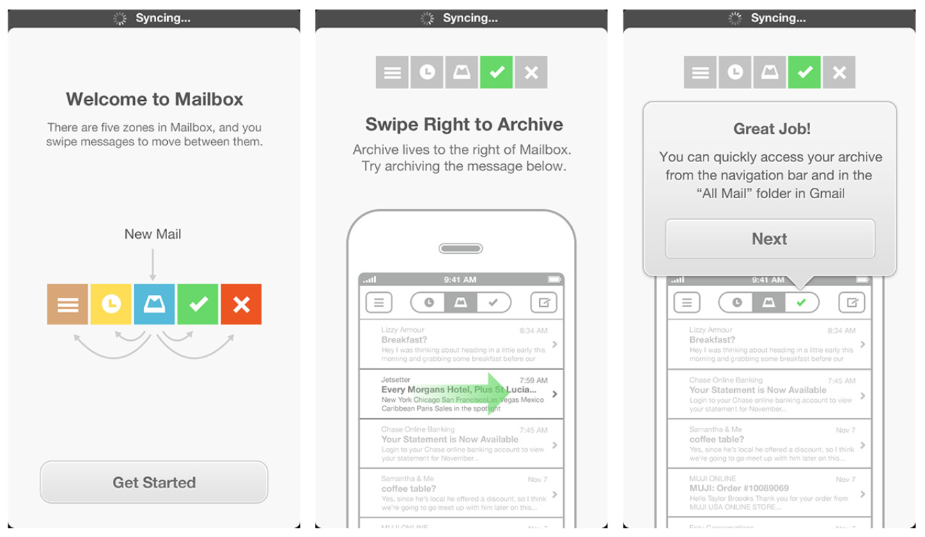
Notes:
FIGURE 7-6.
Mailbox for iOS: the tutorial text encourages the user to learn by doing (http://www. youtube.com/watch ?v=URd0j5vEsHE)

Slide 9
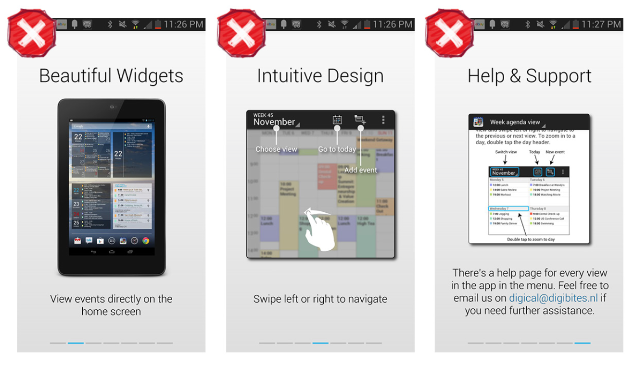
Notes:
FIGURE 7-7.
DigiCal for Android: the text is abstracted from the activities it describes

Slide 10
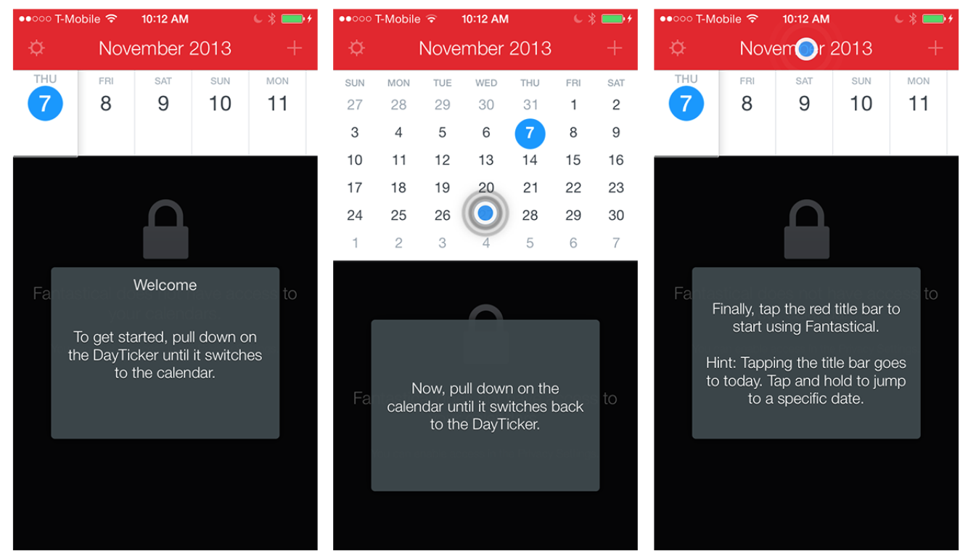
Notes:
FIGURE 7-8.
Fantastical for iOS: the tutorial invites the user to work through the gestures he needs to learn (http://www. youtube.com/watch ?v=e6Q8FbuNwiQ)

Slide 11
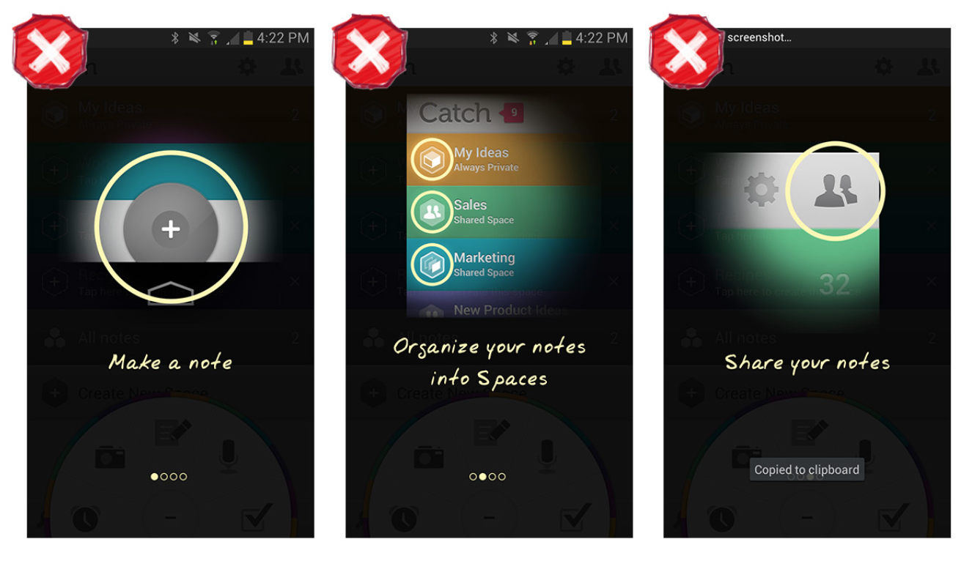
Notes:
FIGURE 7-9.
Catch for Android: the tour describes features and actions, but doesn’t let the user try them

Slide 12
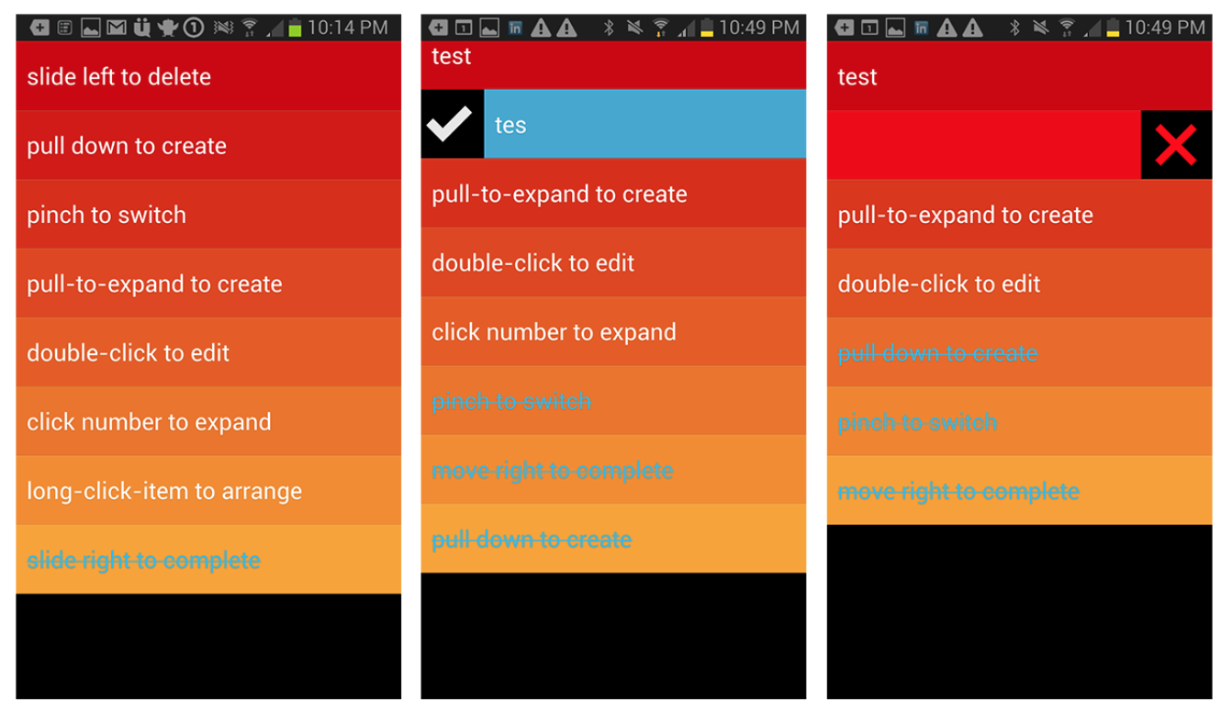
Notes:
FIGURE 7-10.
Clear for Android: the default view is preloaded with tasks that the user learns by doing (http://www. youtube.com/watch ?v=v3gGTG003_A)

Slide 13
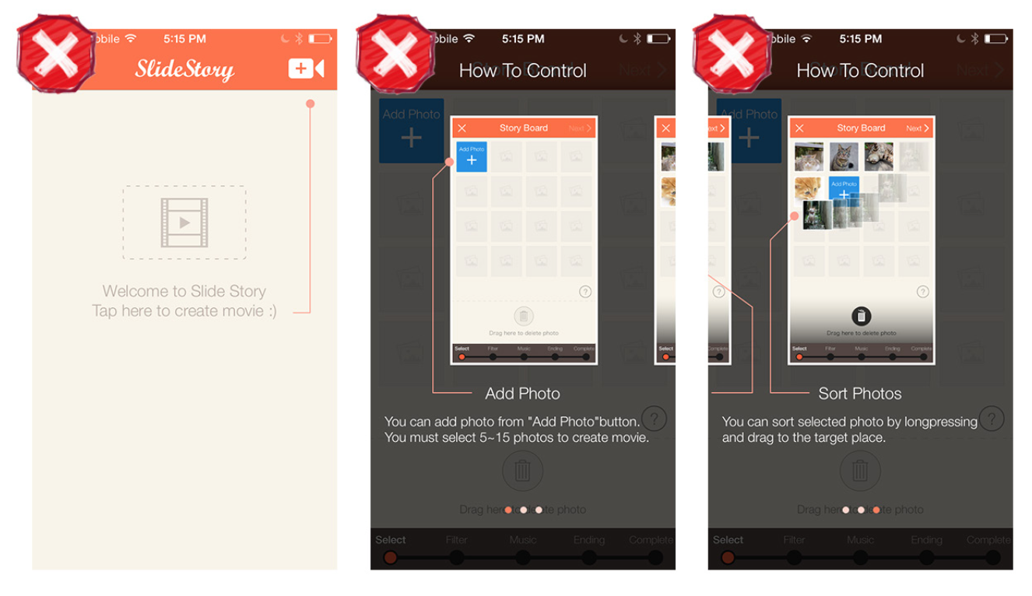
Notes:
FIGURE 7-11.
SlideStory for iOS: this tutorial shows and tells, but doesn’t let the user do

Slide 14
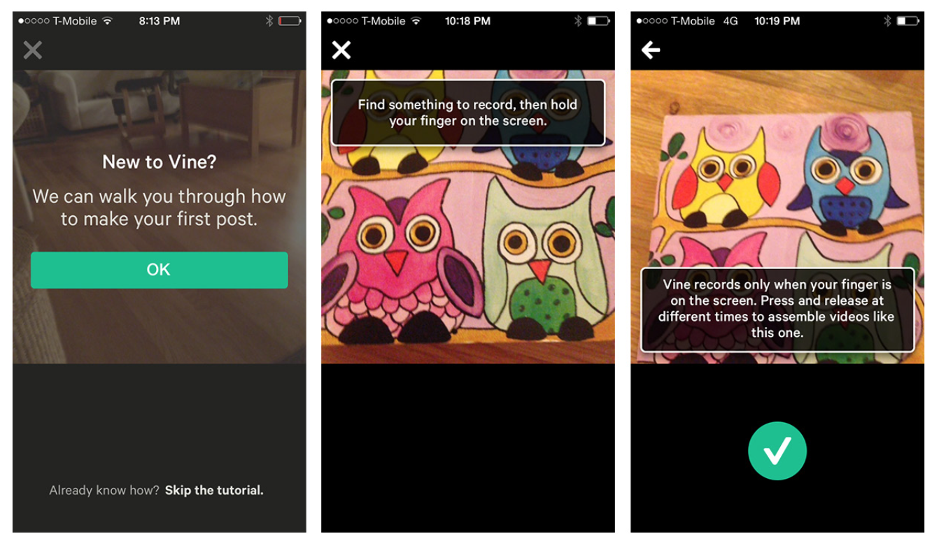
Notes:
FIGURE 7-12.
Vine for iOS shows, tells, and encourages users to try for themselves (http://www. youtube.com/watch ?v=vBOC9DpC5ns)

Slide 15
Rule #2: No Frontloading
“If you frontload your tutorial and teach the player everything at the beginning,” Extra Credits says in Tutorials 101, “they’ll be over- whelmed with information and undersupplied with engagement.” All you have to do is replace the word player with user in that sentence, and its relevance is obvious to app designers.
Rather than overwhelming users with information that they will prob- ably forget by the time they need it, provide the information in short, easily digestible chunks precisely when they need it. Remember, you’re making a first impression here. Wouldn’t you rather make a first impression that leaves users wanting more, rather than less?

Slide 16
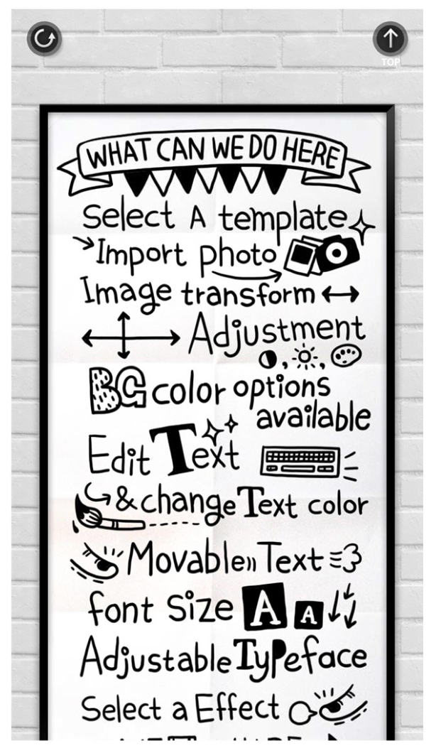
Notes:
Resist the urge to use text if there are ways of showing rather than telling. Use text to prompt the “cause” and let the user observe the “effect” by doing.
FIGURE 7-13.
Phoster for iOS: though only one page, this chaotic layout presents too much information up front

Slide 17
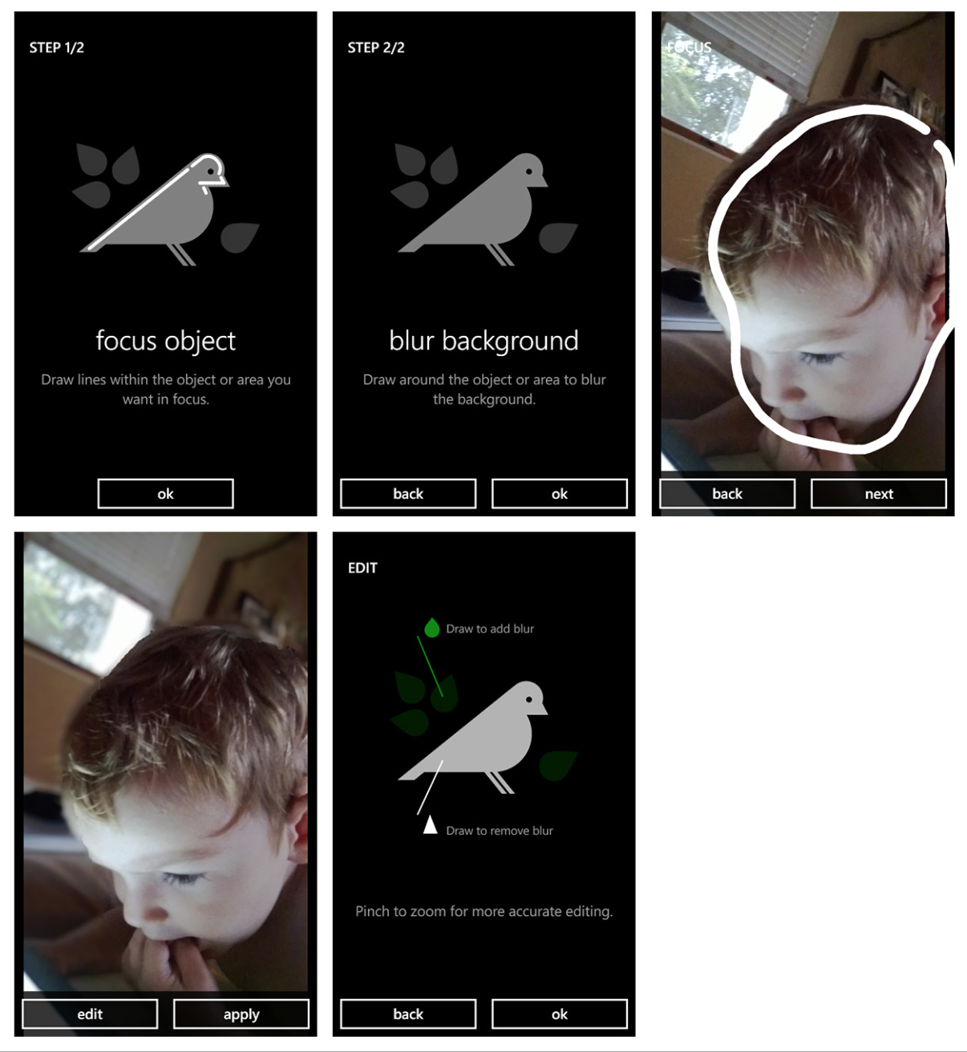
Notes:
FIGURE 7-14.
Creative Studio for Windows Phone offers contextual help when and where the user needs it

Slide 18
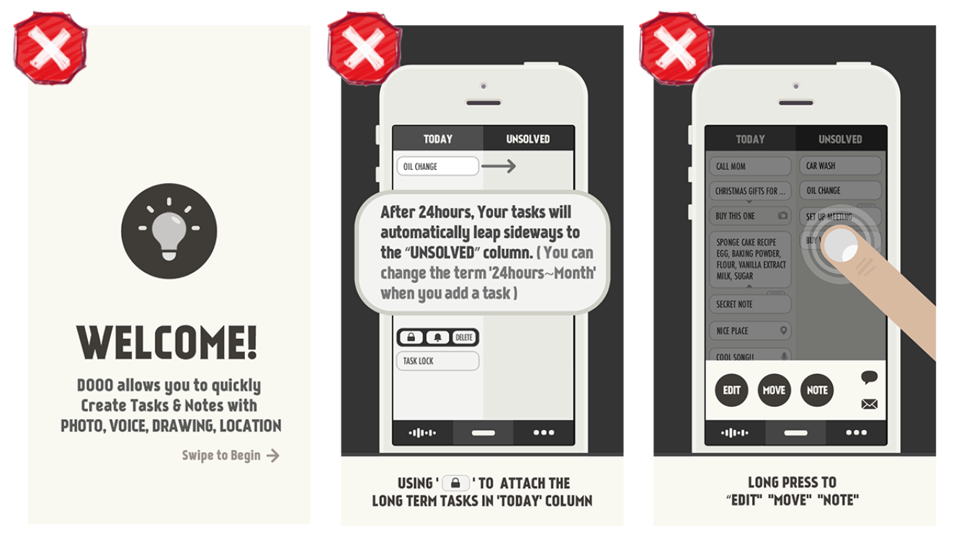
Notes:
FIGURE 7-15.
Dooo for iOS: overwhelming frontloaded information goes on and on (11 pages total)

Slide 19
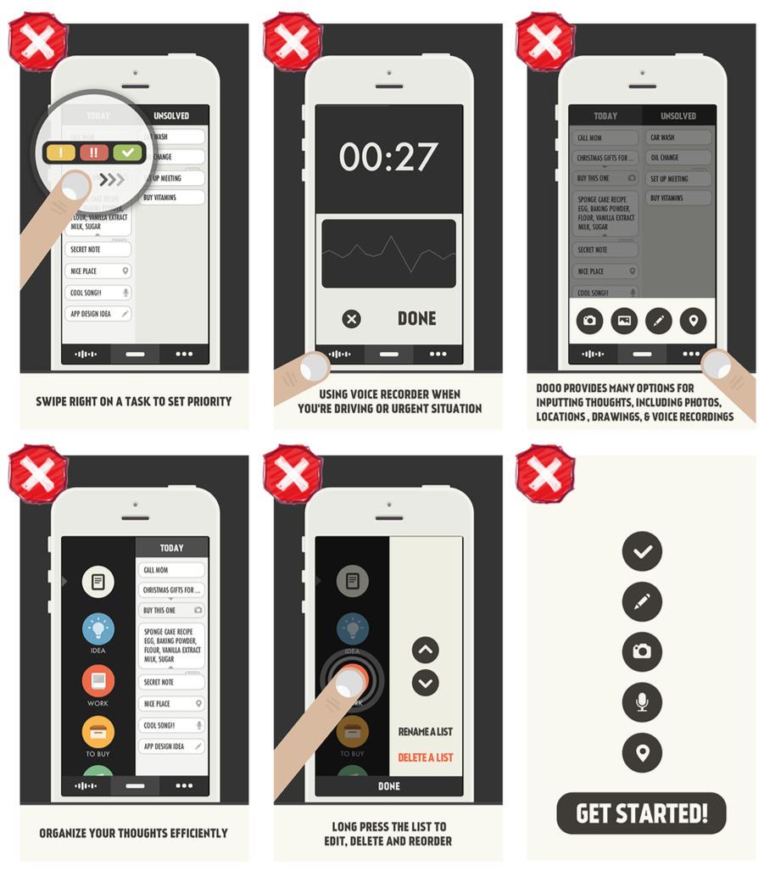

Slide 20
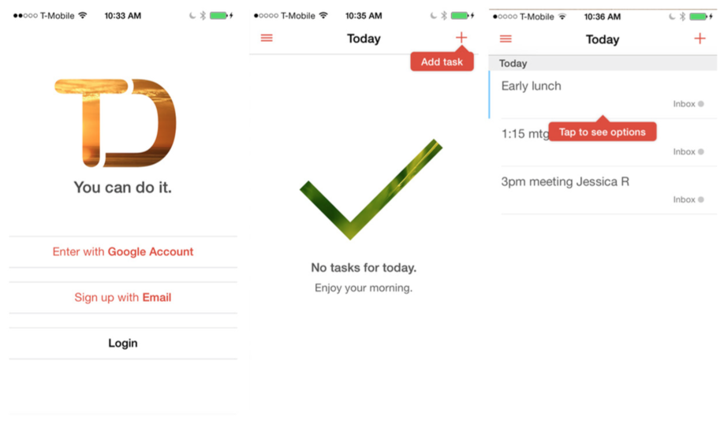
Notes:
FIGURE 7-16.
Todoist for iOS: a tip invites the user to add a first task, and then another prompt introduces the options menu

Slide 21
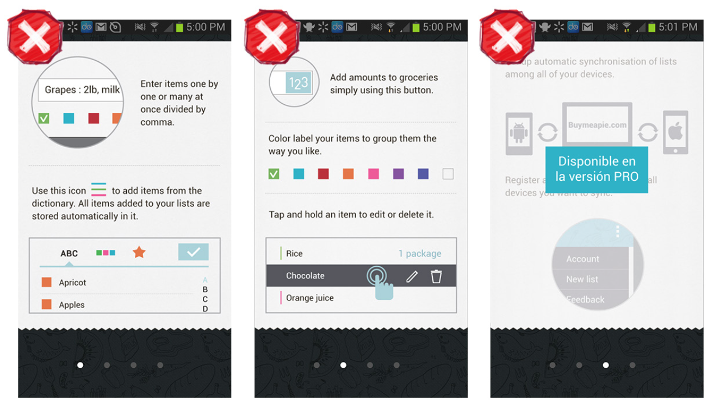
Notes:
FIGURE 7-17.
Buy Me a Pie! for Android: frontloaded, confusing, and out-of- context tour

Slide 22
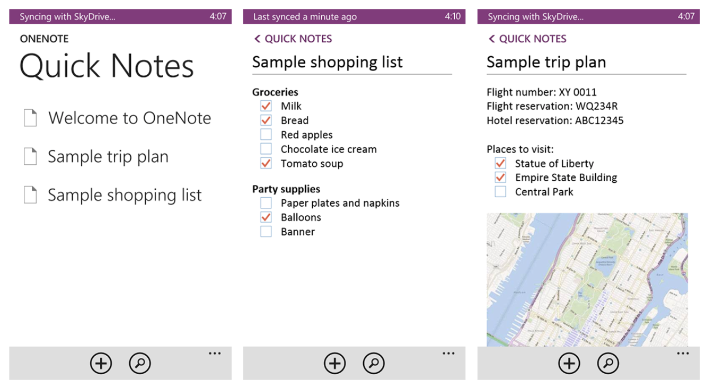
Notes:
FIGURE 7-18.
OneNote for Windows Phone: two sample lists allow users to learn the ropes by doing

Slide 23
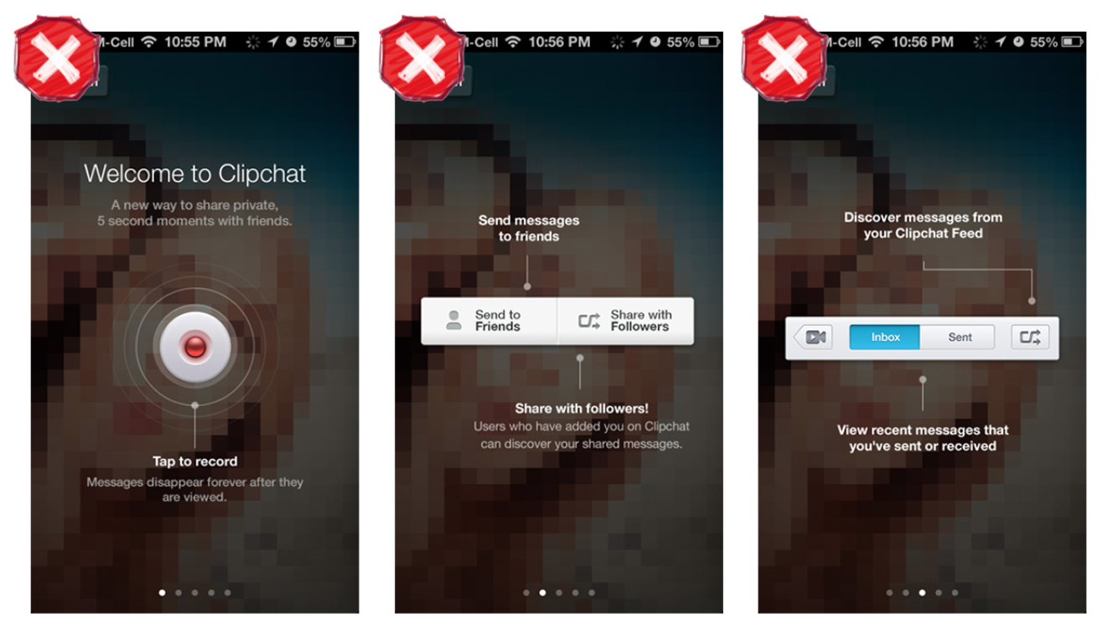
Notes:
FIGURE 7-19.
Clipchat for iOS: too much up-front information, abstracted from usage context

Slide 24
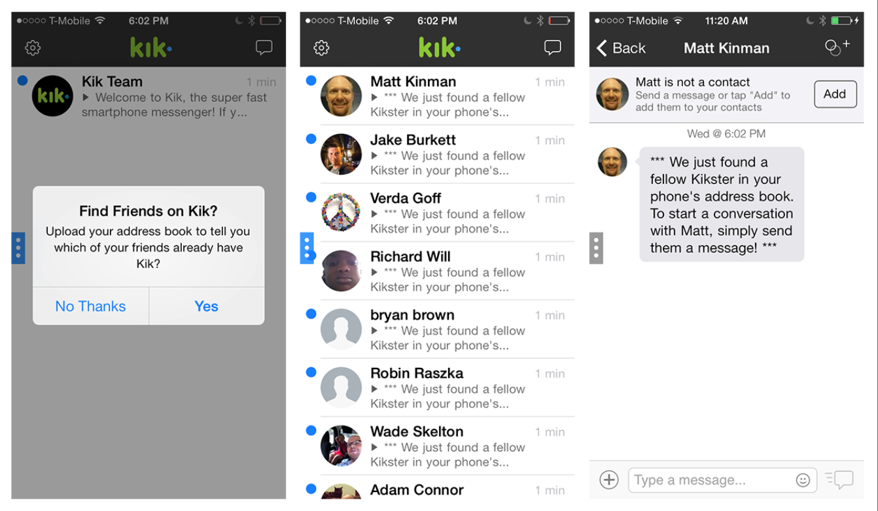
Notes:
FIGURE 7-20.
Kik Messenger for iOS: import contacts and see a tip for how to start chatting with them

Slide 25
Rule #3: Make It Rewarding
Actually, you may recall that the rule from Tutorials 101 is “Make It Fun.” But let’s face it, “fun” is not appropriate for all apps. Still, when the narrator of the video says, “Your tutorial should be as engaging as any other part of your game,” we can see that in every other sense, this rule applies to our world.
Even if we can’t make learning our apps fun, there are certainly ways to make it rewarding and make it flow seamlessly into the overall app experience. One good way to do that is with interactivity that actually lets the user accomplish things. This provides a sense of “agency” that reinforces what we learn.

Slide 26
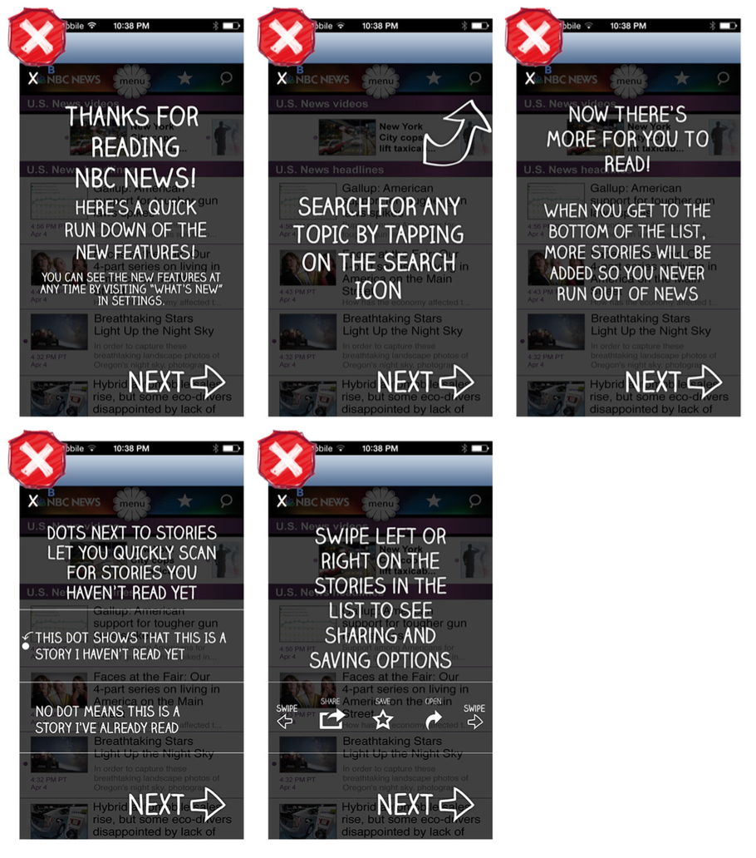
Notes:
FIGURE 7-21.
NBC News for iOS: a playful font, but a long lecture isn’t rewarding

Slide 27
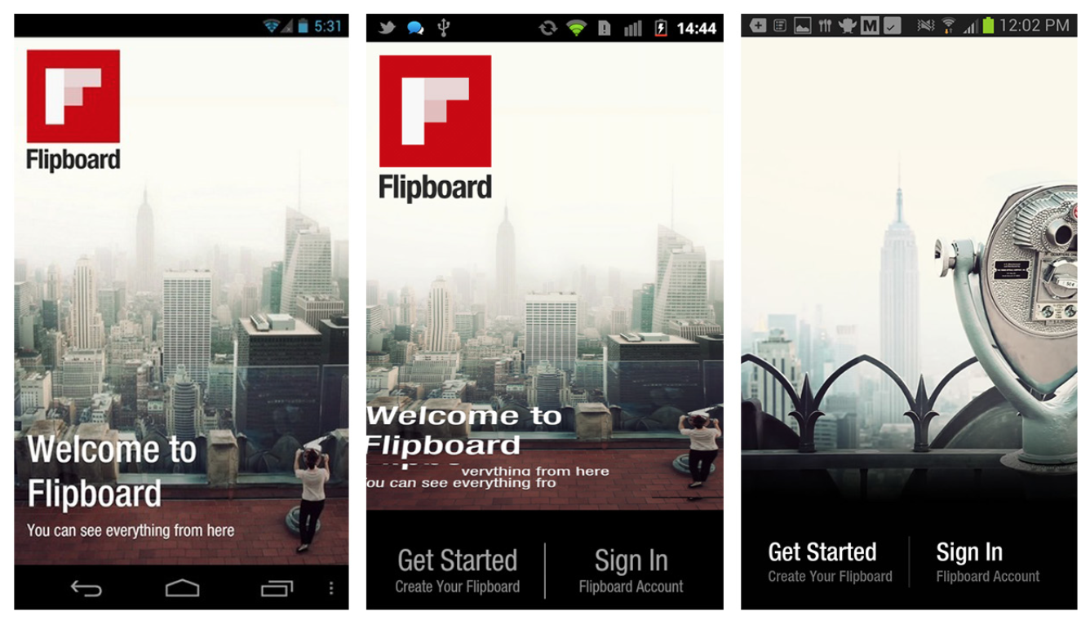
Notes:
FIGURE 7-22.
Flipboard for Android uses playful embedded prompts to engage the user and reinforce the key gestures needed to navigate
the app (http://www. youtube.com/watch ?v=rQASZtuvBCs)

Slide 28
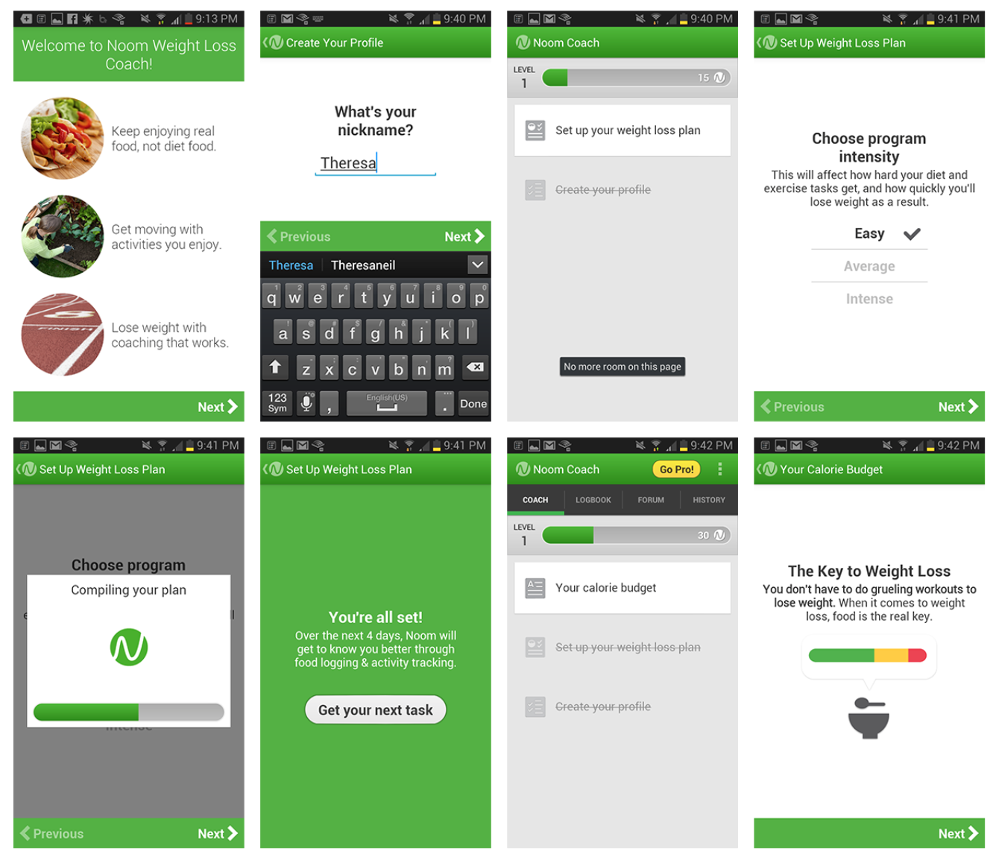
Notes:
FIGURE 7-23.
Noom for Android: guided setup is easy and friendly, with positive feedback along the way
Noom Compared to DailyBurn Tracker
Noom for Android is an incredible app and does a great job of using rewards to invite deeper engagement. The experience is designed from start to finish to engage the user and keep him coming back. Noom uses a Gamification technique (see Chapter 8) called “leveling up” to encourage the user to successfully complete a series of tasks and reach the next level of proficiency.
It also includes an element of surprise to keep things interesting. Just as I completed the setup process, I was rewarded with an “overachiever bonus” that inspired just a little more engagement.
In contrast, setting up DailyBurn Tracker was a chore. It started with a half-dozen configuration screens, then dropped me straight onto the home page with a list of 10 options. No guidance, no motivation, and no surprises. (Motivational apps are one instance where surprises are a good thing.)

Slide 29
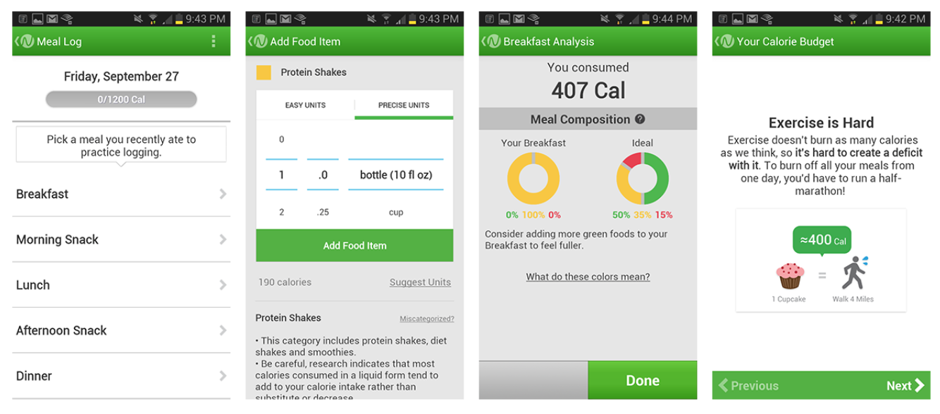
Notes:
FIGURE 7-24.
Noom for Android: the tasks are designed for participation to ensure comprehension (like practice logging a meal)

Slide 30
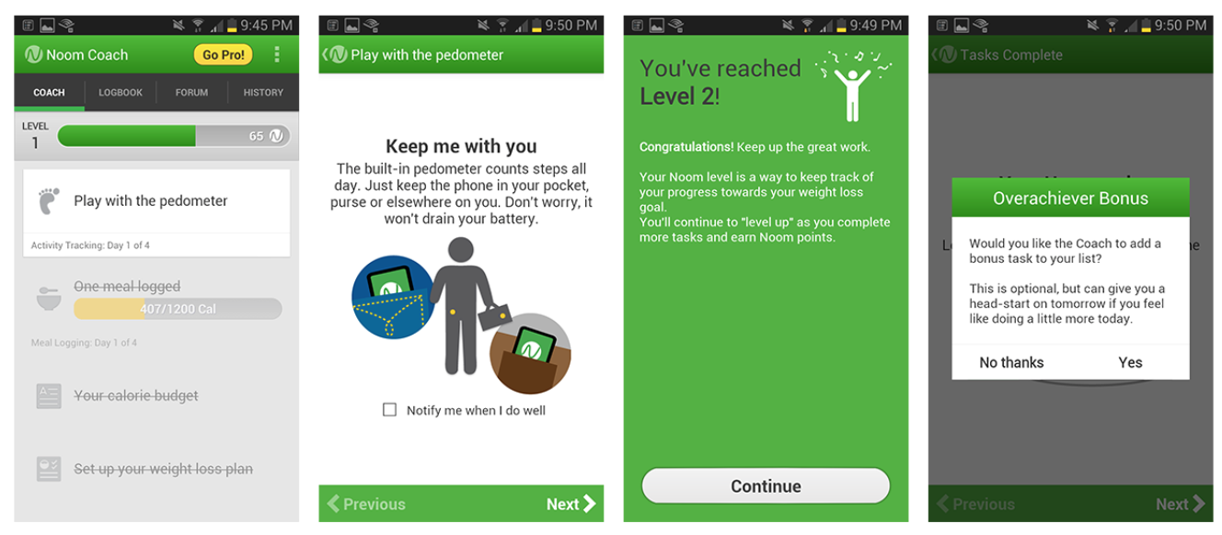
Notes:
FIGURE 7-25.
Noom for Android: tasks start off easy to complete, but get harder as you progress; leveling up “gamifies” the experience and makes it feel more rewarding
If you download Noom for Android today, you may notice some differ- ences between the screenshots shown here (taken in October 2013) and the newest release. I was curious about the catalyst for these changes, so I reached out to Eli Holder, Noom’s VP of Engagement.
According to Eli, user testing showed that the 2013 design left par- ticipants feeling “exhausted.” The redesign is intended to shorten the onboarding process into bite-size chunks and make it more about the user’s weight loss story and less like a task list.
Keep an eye on Noom this year as Eli and his team evolve the onboard- ing flow to more quickly give users a joyful experience and an emotional connection with Noom.

Slide 31
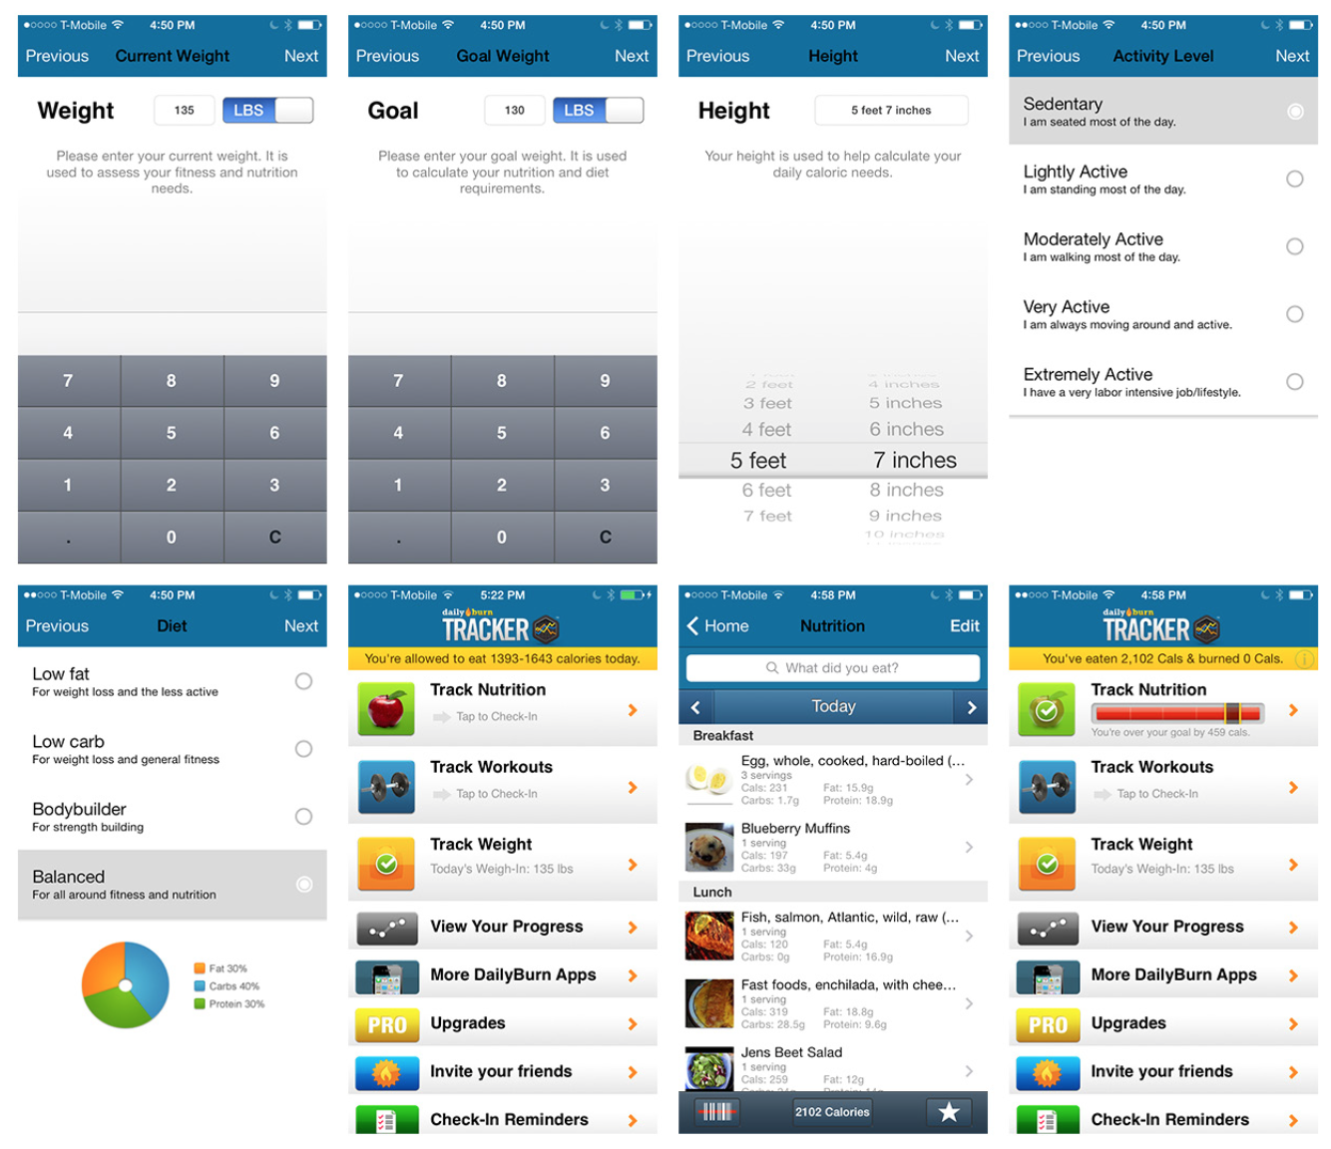
Notes:
FIGURE 7-26.
DailyBurn Tracker for iOS: setup feels like an impersonal, sterile chore
Make deeper engagement with your app rewarding. Consider adding elements of playfulness where appropriate, and let users learn by doing to create a sense of agency.

Slide 32
Rule #4: Reinforce Learning Through Use
Remember those “a-ha!” moments you’d get in science class when you came to understand a concept by demonstrating it in a simple experiment? That’s what we’re talking about here.
Of course, the teacher had told you the concept, but it was through doing the experiment that you actually learned it.
The same idea applies with tutorials. And if you follow the first three rules, this reinforcement will largely take care of itself.

Slide 33
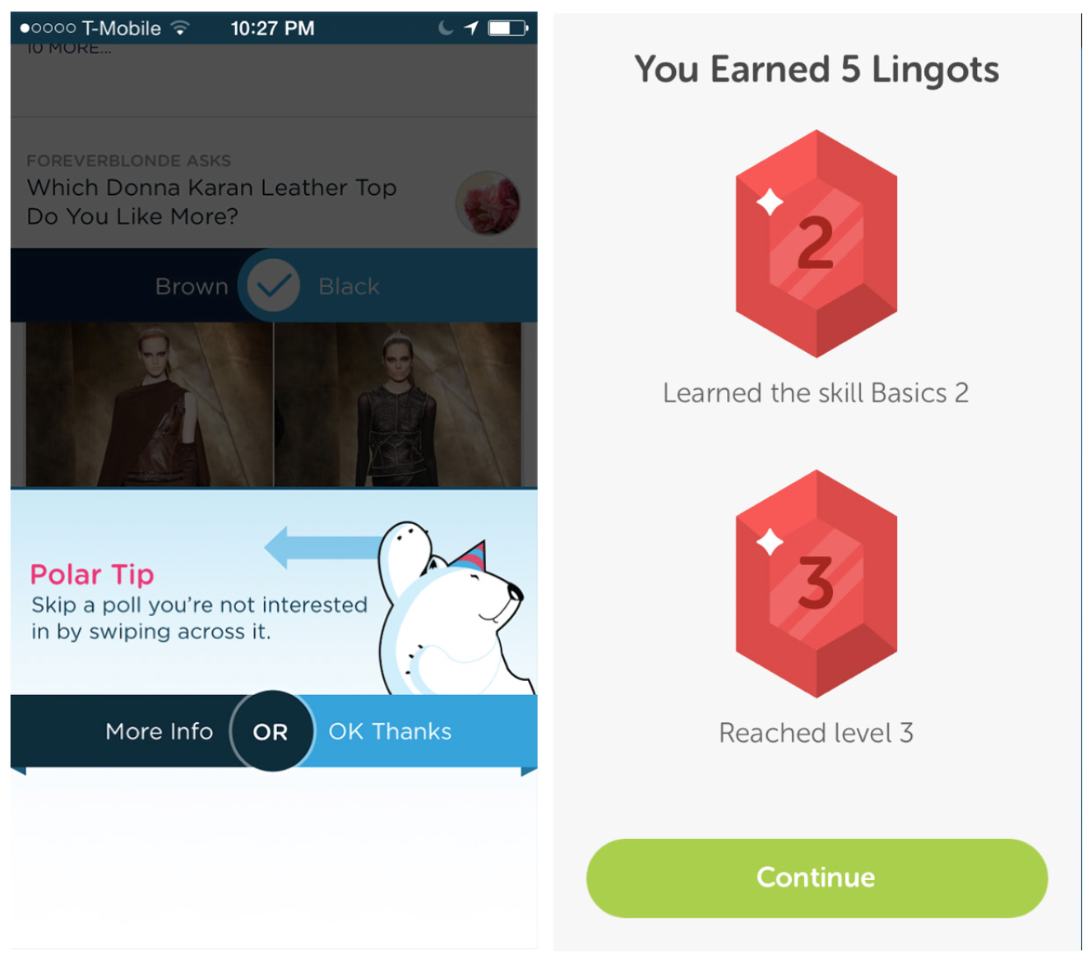
Notes:
FIGURE 7-27.
Polar for iOS: after answering a few polls, I get a tip; DuoLingo for iOS: rewards participation with Lingots
Learning isn’t a one- time thing; using an app should reinforce what the tutorials have helped users learn.

Slide 34
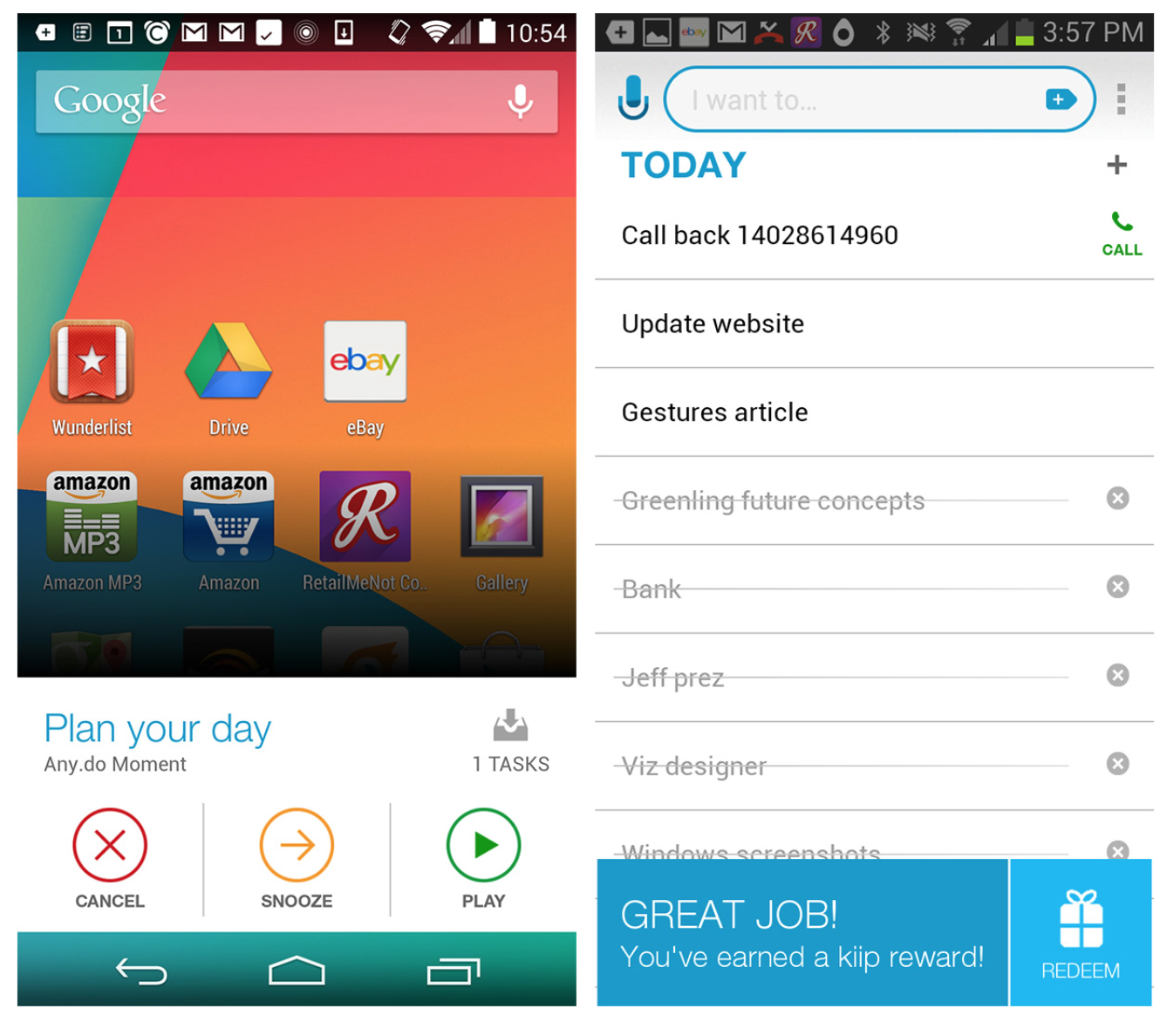
Notes:
FIGURE 7-28.
Any.do for Android uses a widget to encourage engagement and spontaneous rewards for completion

Slide 35
Rule #5: Listen to Your Users
Considering that you’ve been deep inside your app building and refining it for months, who’s the best person to explain to users how it works?
Probably not you, according to the narrator of Tutorials 101, who says: “When you’re a designer who’s been working on a project for a year or two, it’s very easy to think things are intuitive or obvious that are actually totally incomprehensible.”
Long-term exposure to an app blinds us to what users will need to be taught in order to use it.

Slide 36
Don’t wait until the end to design your tutorial.
You must integrate your tutorial into the overall design process from the very beginning.
Too many teams relegate the tutorial to an afterthought, and that couldn’t be more wrong or potentially damaging to the fate of your app.
Many of the tutorial screens I marked as anti-patterns in this chapter probably got to be that way because they were afterthoughts in otherwise well-designed apps.
Tutorials should be treated as one of the most important elements of your app. If they fail, your app fails.

Slide 37
Tutorials should be skippable.
Have you ever used an app that forced you to go through a tutorial every time you opened it?
If so, you probably didn’t use that app for very long.

Slide 38
Anything conveyed in the tutorial should be accessible at all times.
By the same token, any help provided in your tutorials should always be available for reference.

Slide 39
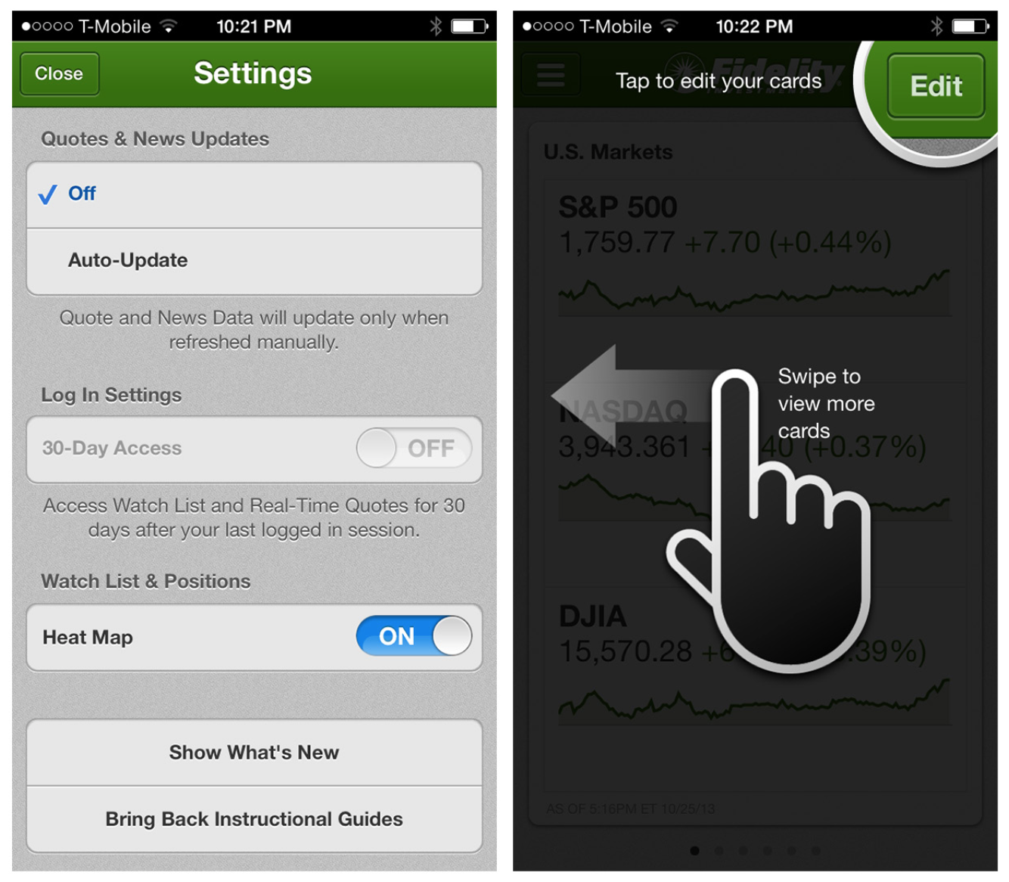
Notes:
FIGURE 7-29.
Fidelity for iOS: Bring Back Instructional Guides lets you relaunch tutorials

Slide 40
Invitation Patterns
Whether or not your application requires a tutorial for onboarding, there are likely opportunities throughout the app to invite users to engage with a specific feature.
Invitations are also helpful to introduce new features within a specific flow, as opposed to just showing a dialog on launch with a list of new features.

Slide 41
Tips
Tips should be specific to a particular tool or action on the screen.

Slide 42
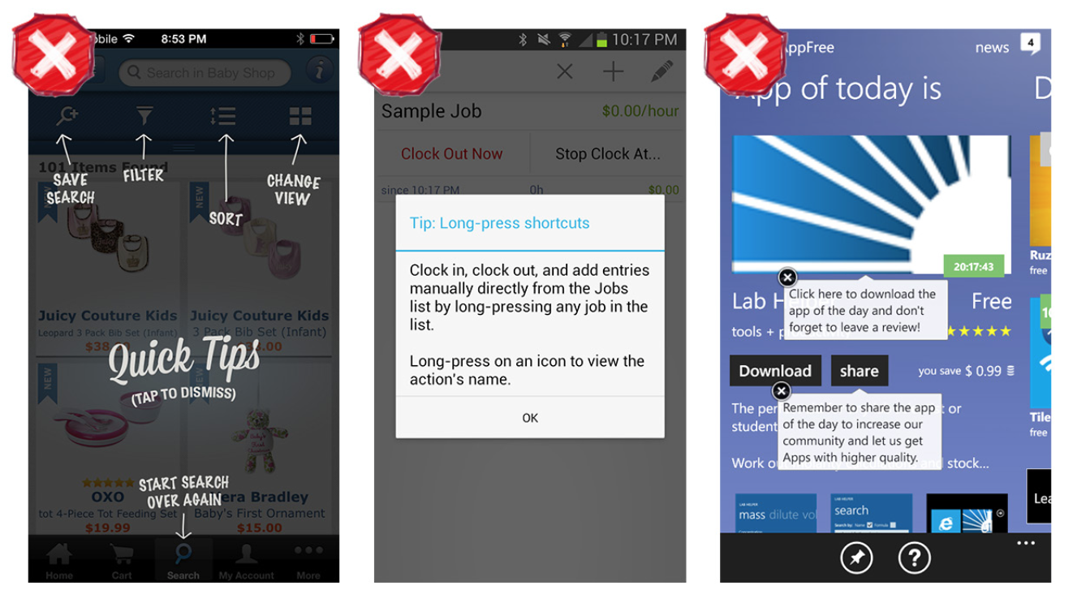
Notes:
FIGURE 7-30.
Zappos for iOS, HoursTracker for Android, and myAppFree for Windows Phone: poorly designed Tips
Tips in the form of Transparencies (Zappos) or Dialogs (HoursTracker) should be avoided, as should multiple tips per screen, as in myAppFree. For smart Tip design, see the examples from Evernote Food and Mint.

Slide 43
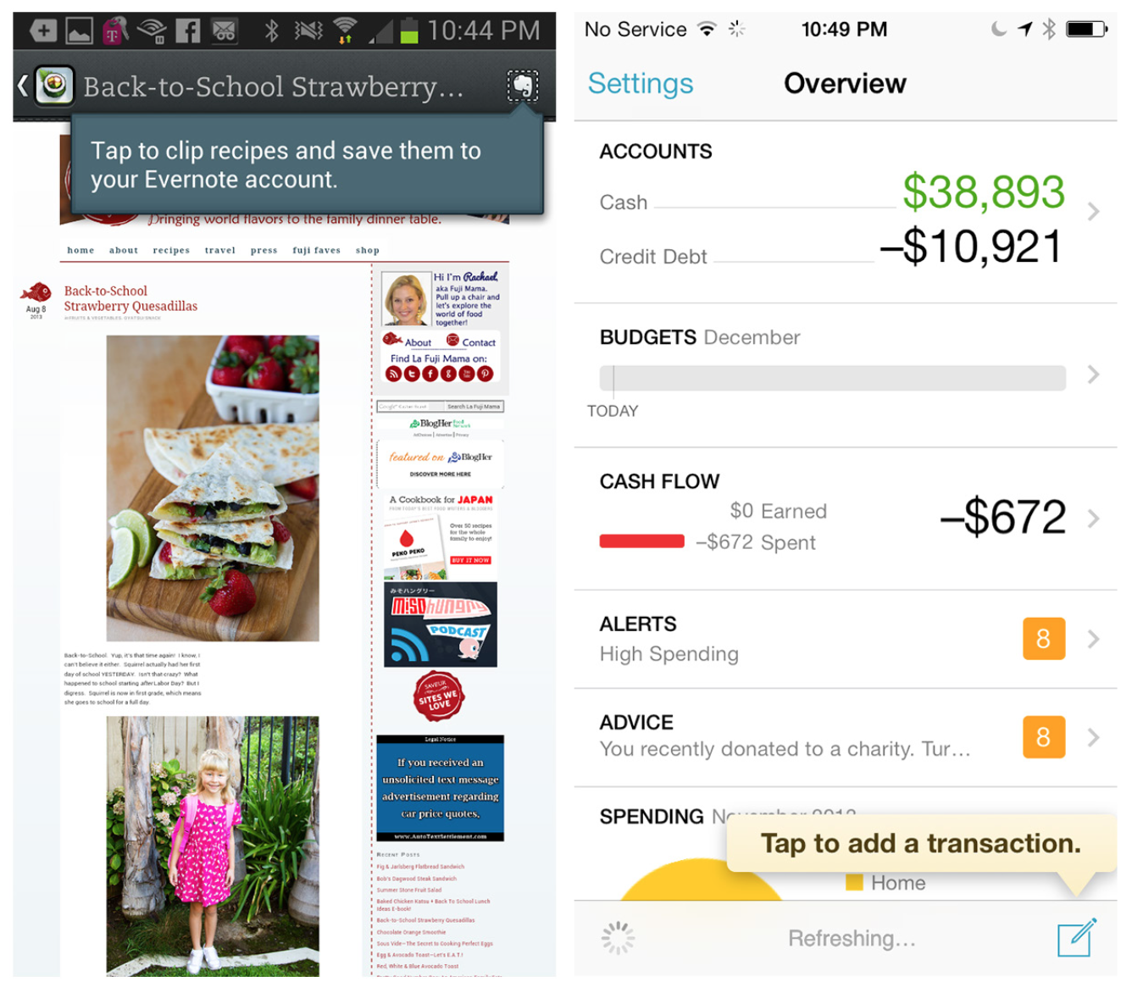
Notes:
FIGURE 7-31.
Evernote Food for Android and Mint for iOS: well-designed Tips

Slide 44
Persistent Invitations
Persistent Invitations might look like Tips in some instances, but they differ in their, well, persistence. These invitations are either always visible, or remain visible until the user takes the specified action.

Slide 45
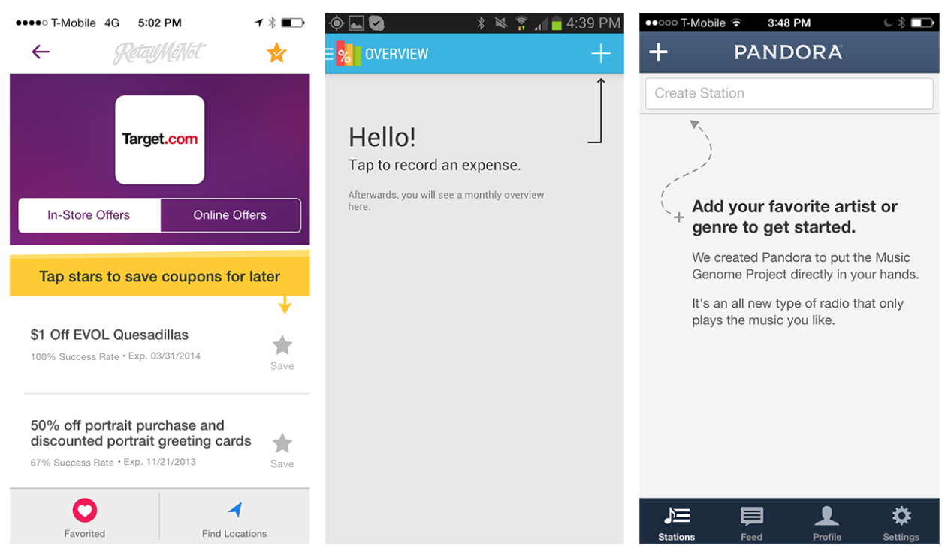
Notes:
FIGURE 7-32.
RetailMeNot for iOS, Expense Manager for Android, and Pandora for iOS: Persistent Invitations

Slide 46
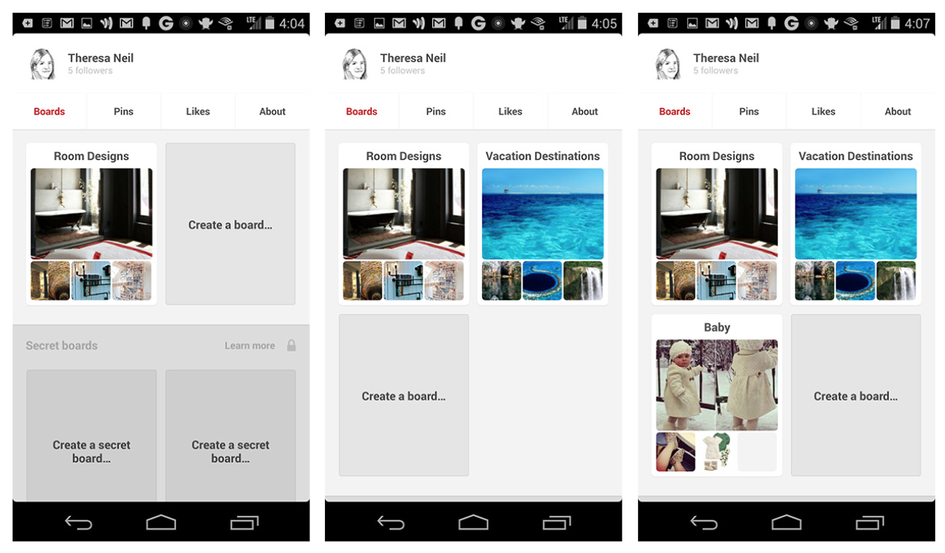
Notes:
FIGURE 7-33.
Pinterest for Android: Persistent Invitation

Slide 47
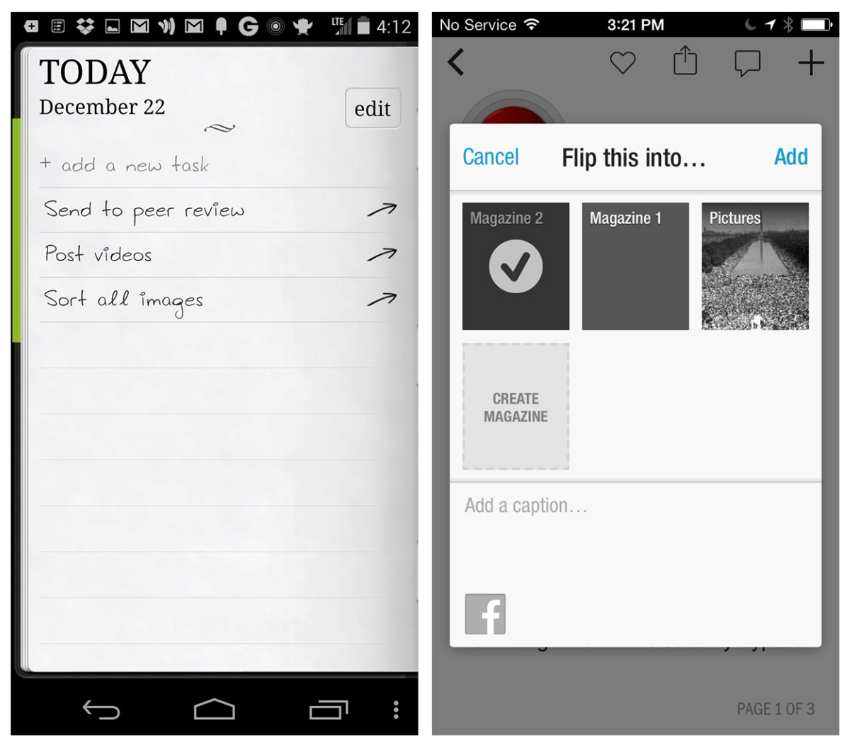
Notes:
FIGURE 7-34.
Do It (Tomorrow) for Android and Flipboard for iOS: invitations can go at the beginning or end of a list

Slide 48
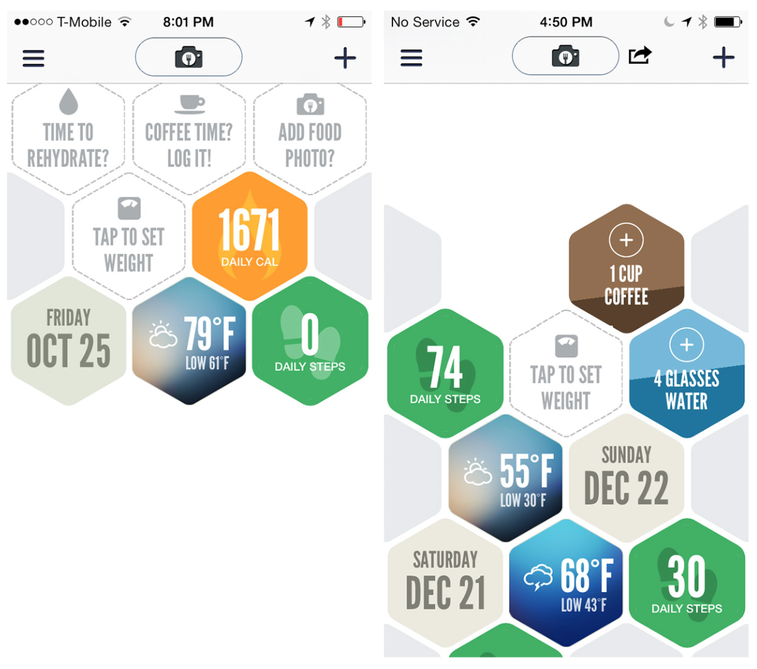
Notes:
FIGURE 7-35.
Argus for iOS: invitation to set weight reappears based on user’s goal settings

Slide 49
Discoverable Invitations
A Discoverable Invitation might seem like an oxymoron, but it is an effective way to encourage specific interactions without cluttering the screen.
These invitations are meant to be discovered when the user performs a common gesture, like tapping, pulling, or swiping.

Slide 50
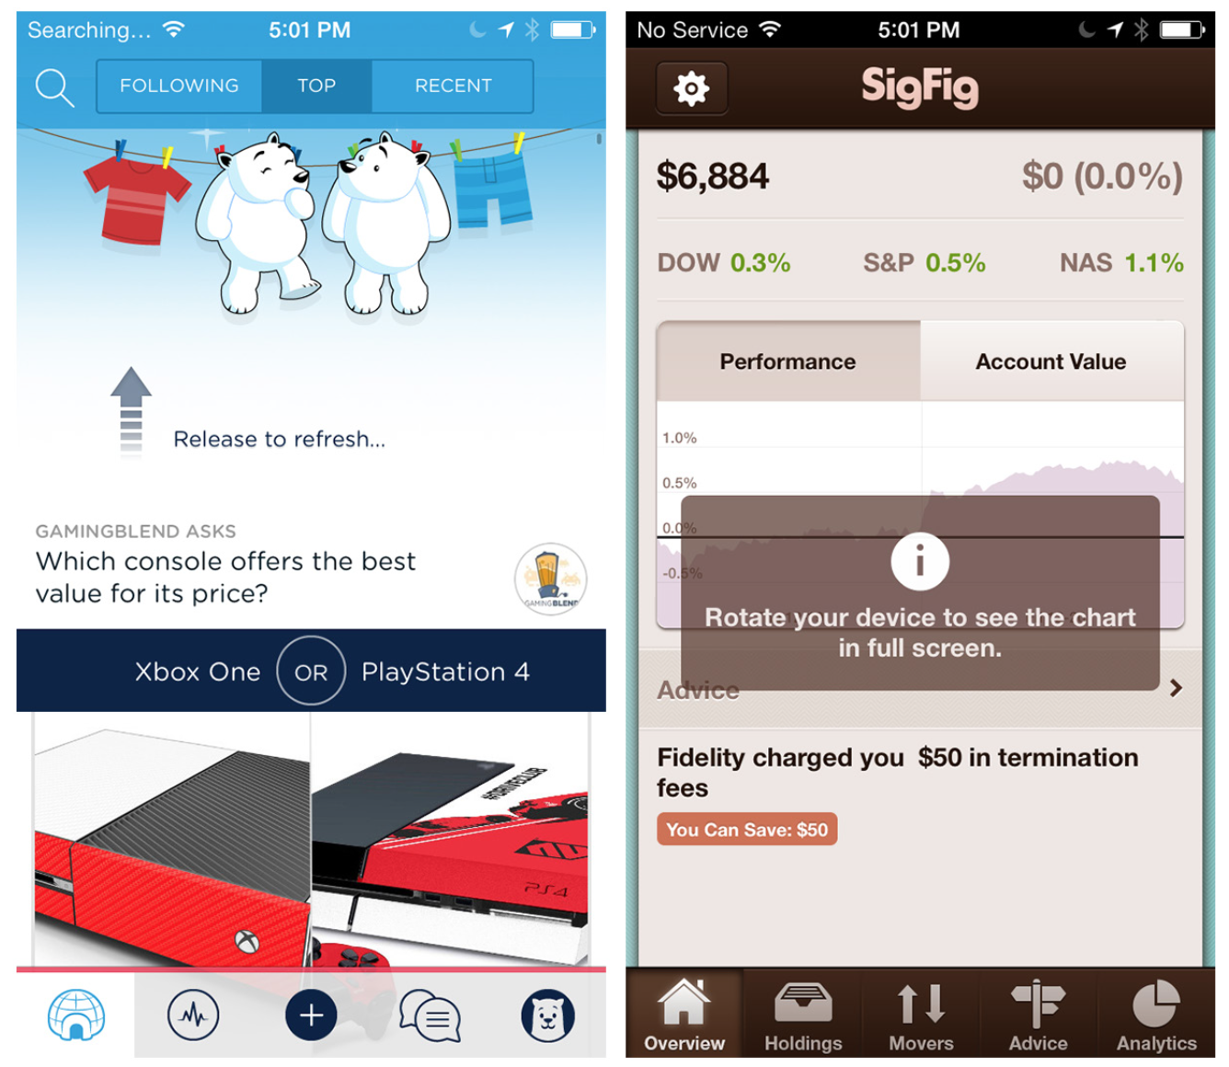
Notes:
FIGURE 7-36.
Polar and SigFig for iOS: Discoverable Invitations

Slide 51
Iterating on the Welcome Experience
To understand which design approach would be most effective for inspiring confidence, we got customer feedback on a variety of design concepts.

Slide 52
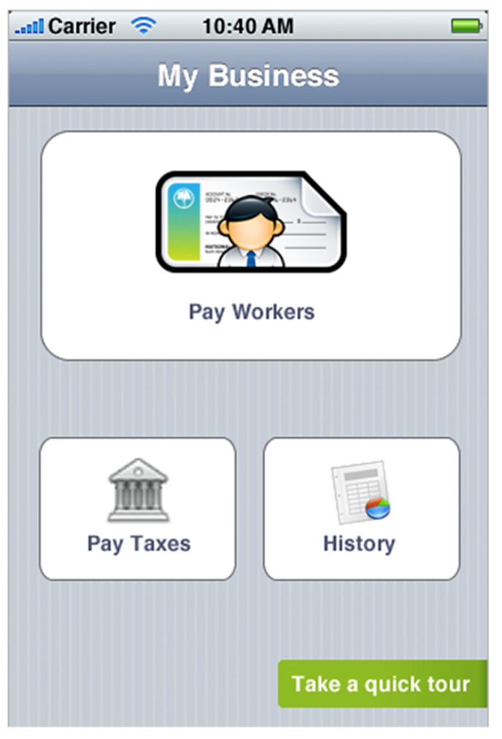
CONCEPT #1: DIRECT IMMERSION
Our first concept was to ditch the “welcome mat” altogether and drop users directly into the app menu that they would rely on during ongoing use.
Customers found this confusing and felt lost. They weren’t sure which option they should choose first, and that added to their anxiety about doing payroll on their own. To continue the dinner-party metaphor, it was as if our guests magically appeared in the center of a party where they didn’t know anyone and the host was not in sight. To welcome them in, we needed to provide additional context.
Notes:
FIGURE 7-37.
No welcome mat: just drop users right in

Slide 53
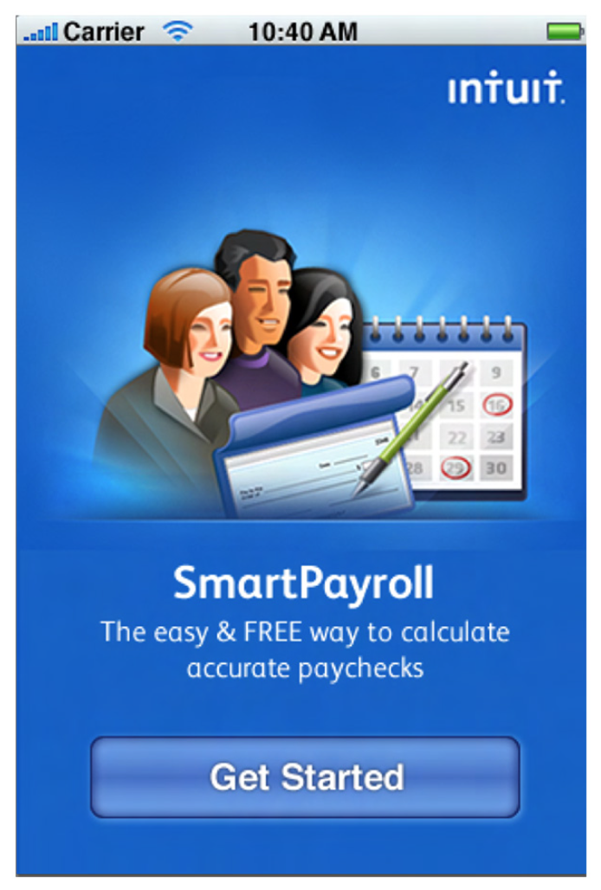
CONCEPT #2: TOUR
We called upon a common invitation pattern—the Tour—to provide additional context. Curious to see which format was most effective, we tested the four versions shown.
Notes:
FIGURE 7-38.
Benefit statement: an image, short benefit statement, and clear call to action

Slide 54

Notes:
FIGURE 7-39.
Feature list: a benefit statement and short description of core functionality

Slide 55
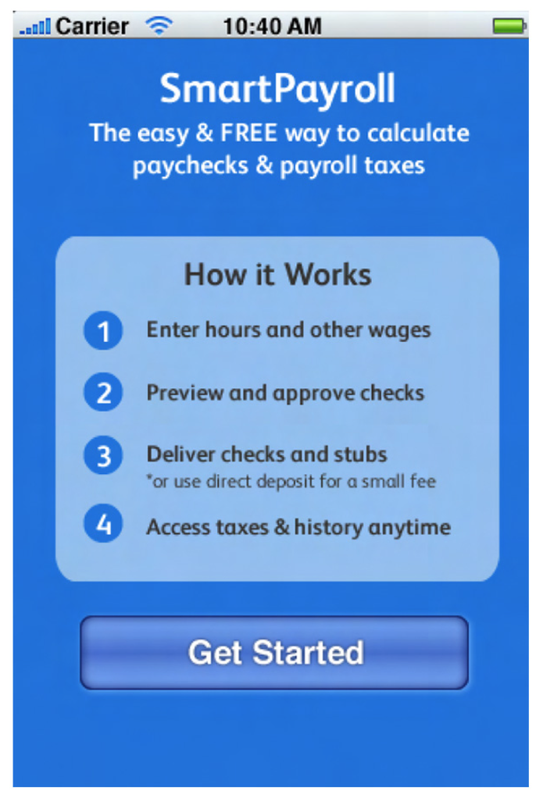
Notes:
FIGURE 7-40.
Step list: a step-by-step list explaining how to use the app

Slide 56
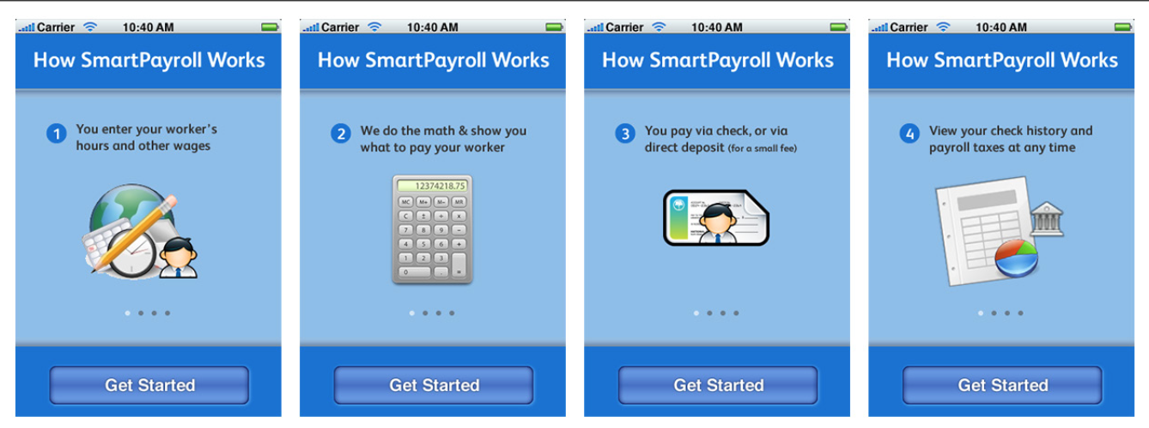
Notes:
FIGURE 7-41.
Multi-step tour: a series of introductory screens that users could swipe through to learn more about the app
Users responded consistently to all of these: no one read the screens or swiped through the feature lists.
Instead, they immediately skipped over them and tapped Get Started.
Users explained that the screens got in their way and that they’d rather just jump into the experience immediately.
Providing context via an up-front informational message did not aid user confidence.
It was like the dinner guests reached our door and found a note explaining how a dinner party works, and inviting them to let themselves in.
We needed to set the proper context—without getting in the way.

Slide 57
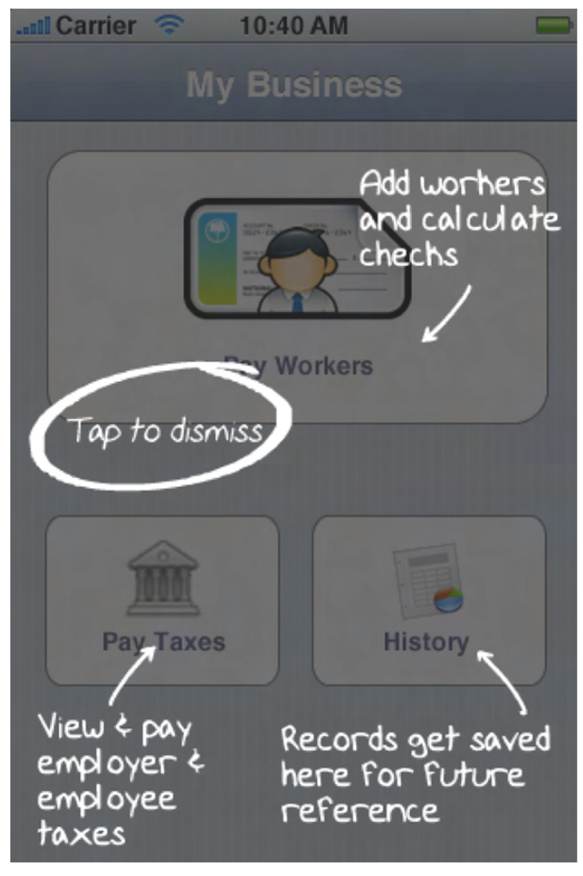
CONCEPT #3: MULTI-STEP TRANSPARENCY
To provide context without interrupting user flow, we tried another common pattern: Transparency.
With this pattern, the user can see the actual app interface, but with additional context overlaid on top.
We tried several approaches to overlays, two of which are shown here.
Notes:
FIGURE 7-42.
Multi-step transparency: multiple features are called out on the main navigation screen

Slide 58
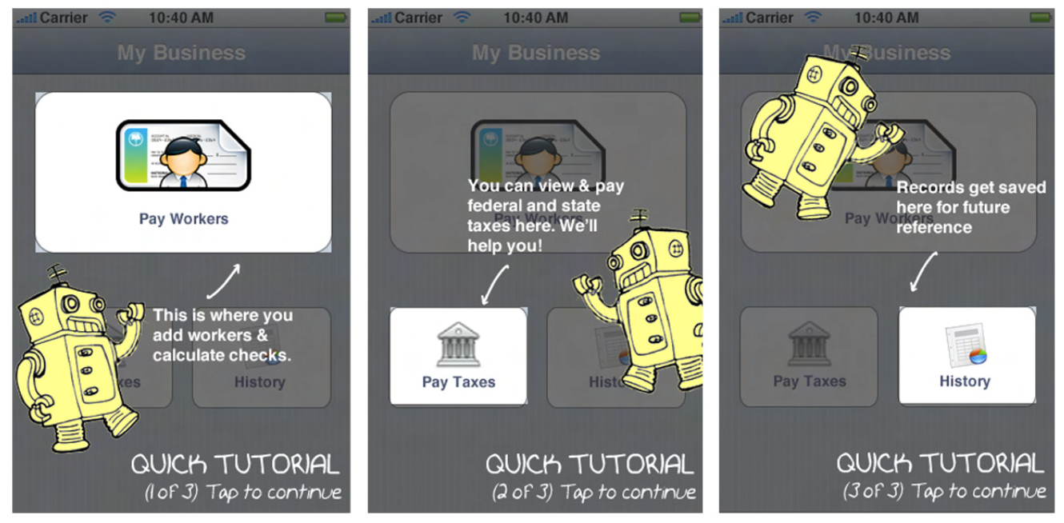
Notes:
FIGURE 7-43.
Multi-step transparency tour: a series of steps that the user needs to tap through, each de- scribing a navigational element
Although users liked being able to see the app in the background, they were irritated by how many instructions were on the screen. Comments included: “I don’t have time to try to understand this,” “I just want to make this get out of my way,” and, of course, “Do I have to read all this?”
We were getting closer, but showing too many instructions at one time made customers feel like there was too much to learn. It was like our dinner host had welcomed them in, suggested 10 different guests they ought to meet, and then left them standing in the hall with their heads spinning. How could we make the experience even easier?

Slide 59
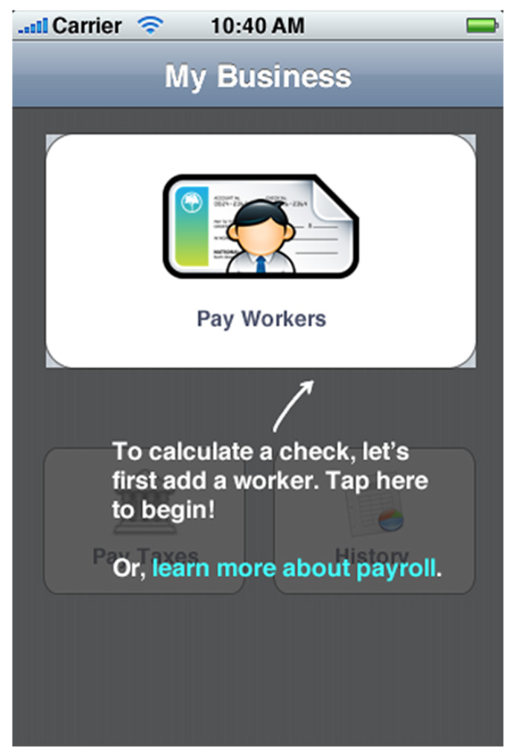
CONCEPT #4: SINGLE-STEP TRANSPARENCY
We adapted our transparency concept to focus on just the one thing a user should do upon first entering the app.
Notes:
FIGURE 7-44.
Single-step transparency: a focus on the most important thing
Customers responded more favorably to this. They liked being able to get a sense of all of the options that would be featured in the app, but also liked having a clear recommendation about where to start.
But the concept also made users a little nervous. Customers asked, “If you have a tutorial, does this mean the app is too complicated for me to figure out for myself?” We also observed users trying to tap on the gray background to close the overlay and get a better view of what was behind it. We saw an opportunity to simplify even more and further get out of the user’s way.

Slide 60
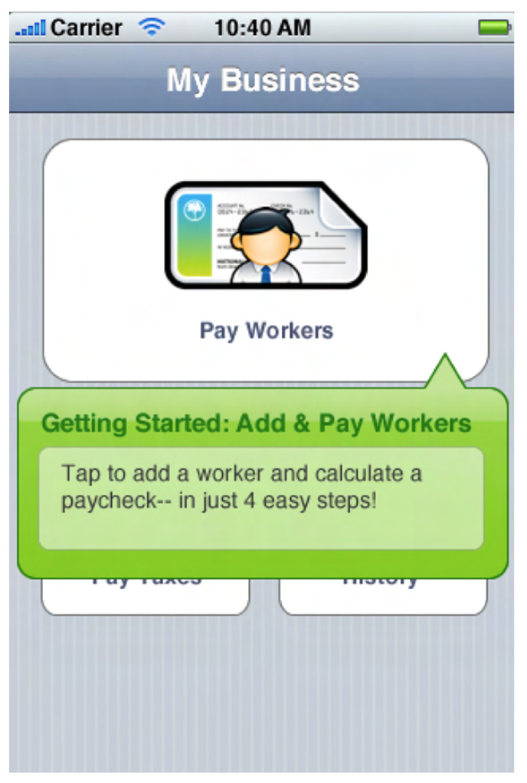
CONCEPT #5: TIP
In this concept, we kept what was working well about the single-step transparency (one clear call to action and a visible menu), while fixing some of the problems (tutorial link and gray overlay).
In this concept, the user saw one call to action in the form of a tip, and could tap elsewhere on the screen in order to hide it.
This tested very well. Customers had a good sense of where they were and what was available to them, as well as a clear first step. At last, we could make our dinner-party guests feel welcome and confident, while introducing them to “a menu item you simply must get to know!”
Notes:
FIGURE 7-45.
Tip: one call to action, with the rest of the screen tappable

Slide 61
Get out of the way
Don’t obscure elements of the UI or force users to sit through an unwanted tour; it feels like you’re hiding something.
Provide guidance
Remove friction and uncertainty by suggesting the first step in the workflow.

Slide 62
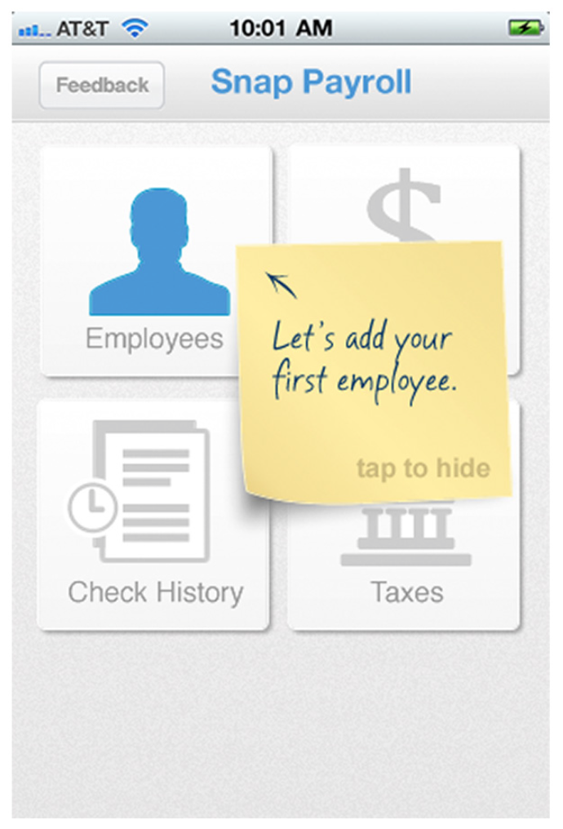
Notes:
FIGURE 7-46.
Pre–iOS 7 implementation: hideable sticky note
This has been very successful in transforming our customers’ fears into confidence. Users quickly understand the functionality the app offers, while also feeling that they know how to proceed in order to have a positive experience.

Slide 63
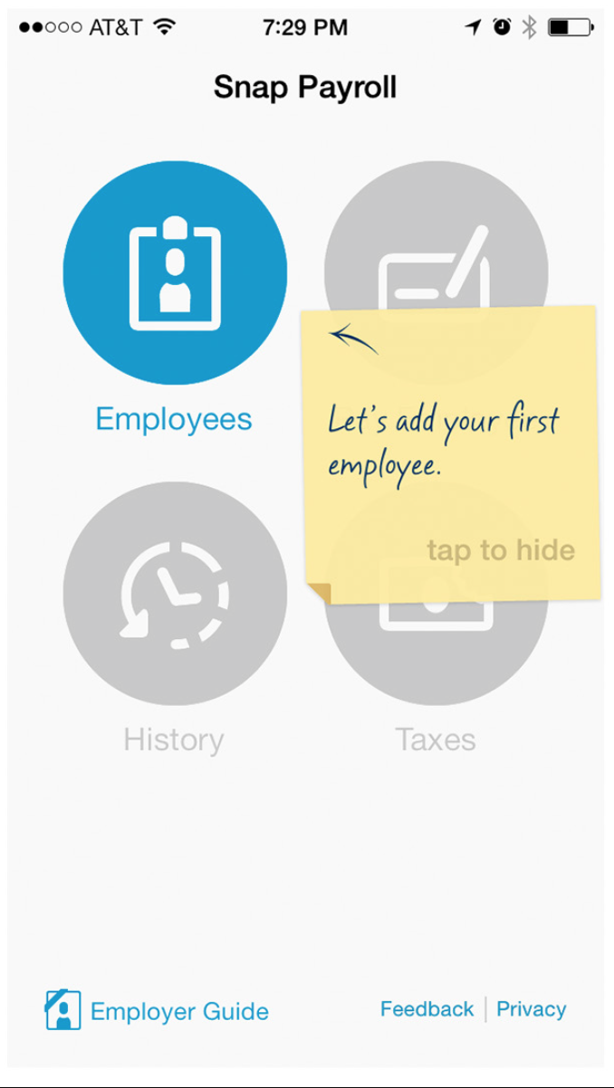
Notes:
FIGURE 7-47.
iOS 7 implementation: helpfulness that doesn’t get in the way
With the introduction of iOS 7, we used subtle translucency and ani- mation effects to strike the right balance of openness and guidance. In this example, the menu loads first and then the sticky note fades, conveying helpfulness while staying out of the way.

Slide 64
Summary
When it comes to inviting your customers into your app, don’t just point to the door and expect them to let themselves in.
Take the time to craft a thoughtful experience that makes them feel welcome and confident. You’ll leave them looking forward to their next visit.

